Slide 1
Project-Build3

Slide 2
Concordia University
Department of Computer Science and Software Engineering
Advanced Programming Practices
SOEN 6441 --- Winter 2024
Professor: Joey Paquet
Students: Team 14
Mahdieh Shekarian-40279366
Parsa MohammadRezaei-40277489
AmirMohammad RezaeiPour-40279239
Farid Farahmand-40241630
Mohammad Aminan-40277902
Omer Sayem-40226505

Slide 3
Agenda
Code Architecture
Code Explanation
Project Structure
Code
Model
Player
Continent
Country
Game State
Orders
Card
LogEntryBuffer
Observable
Controller
Command
Country Controller
Map Controller
Order Controller
Player Controller
Services
CustomPrint
GameGraphUtils
GameMapReader
Phases
Phase
EditMapPhase
ExecuteOrderPhase
FinishPhase
IssueOrderPhase
StartUpPhase
Game Engine
View
FileLogObserver
Observer
App
Game Menu
Test
GitHub Pictures
JavaDoc Pictures

Slide 4
Code Explanation

Slide 5
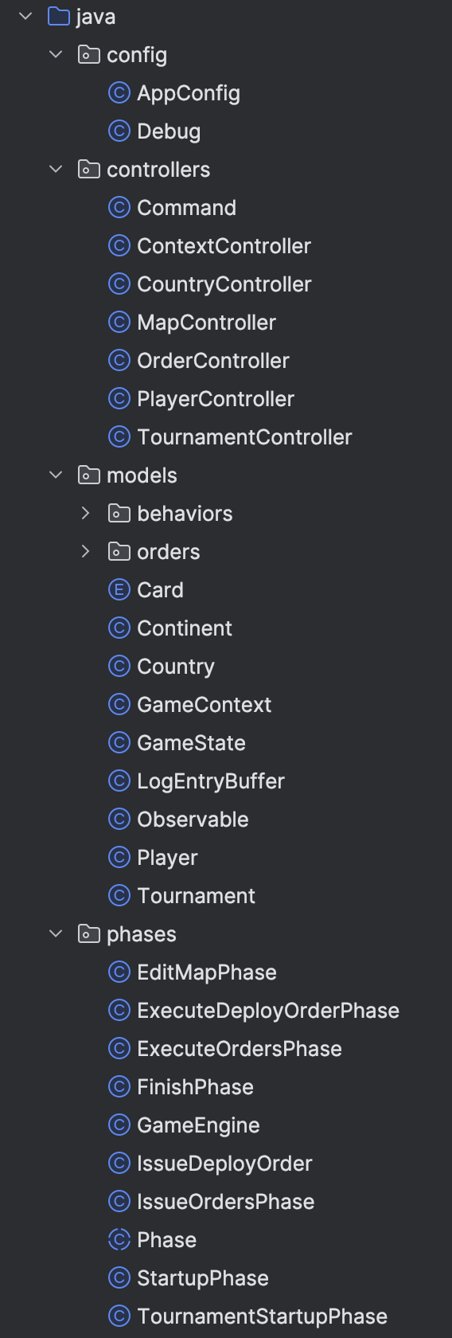
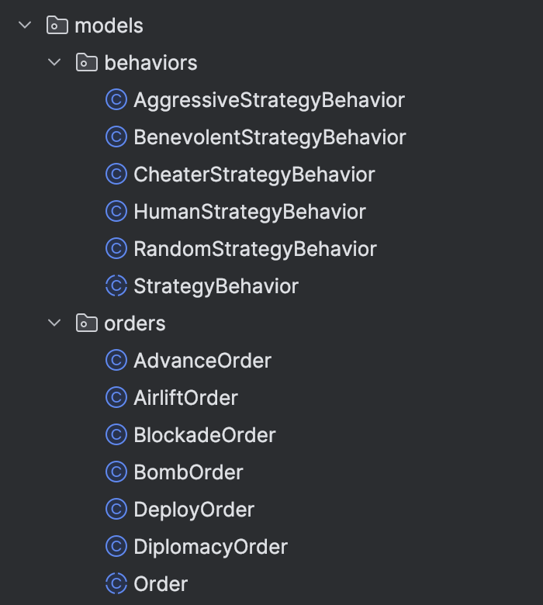
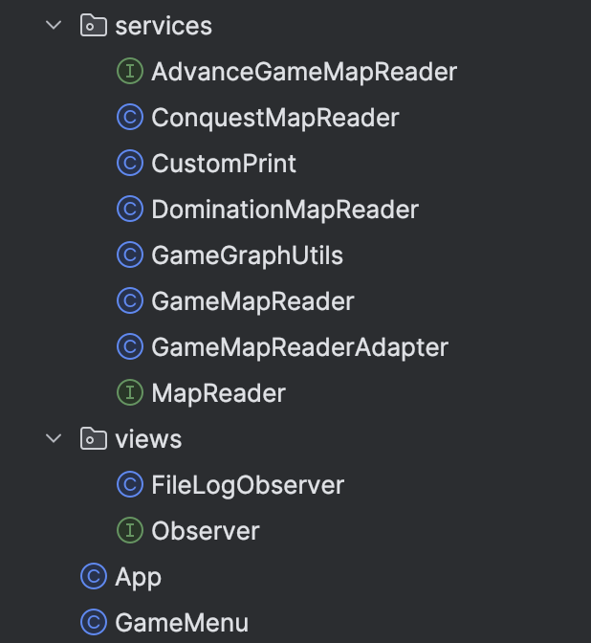

Slide 6
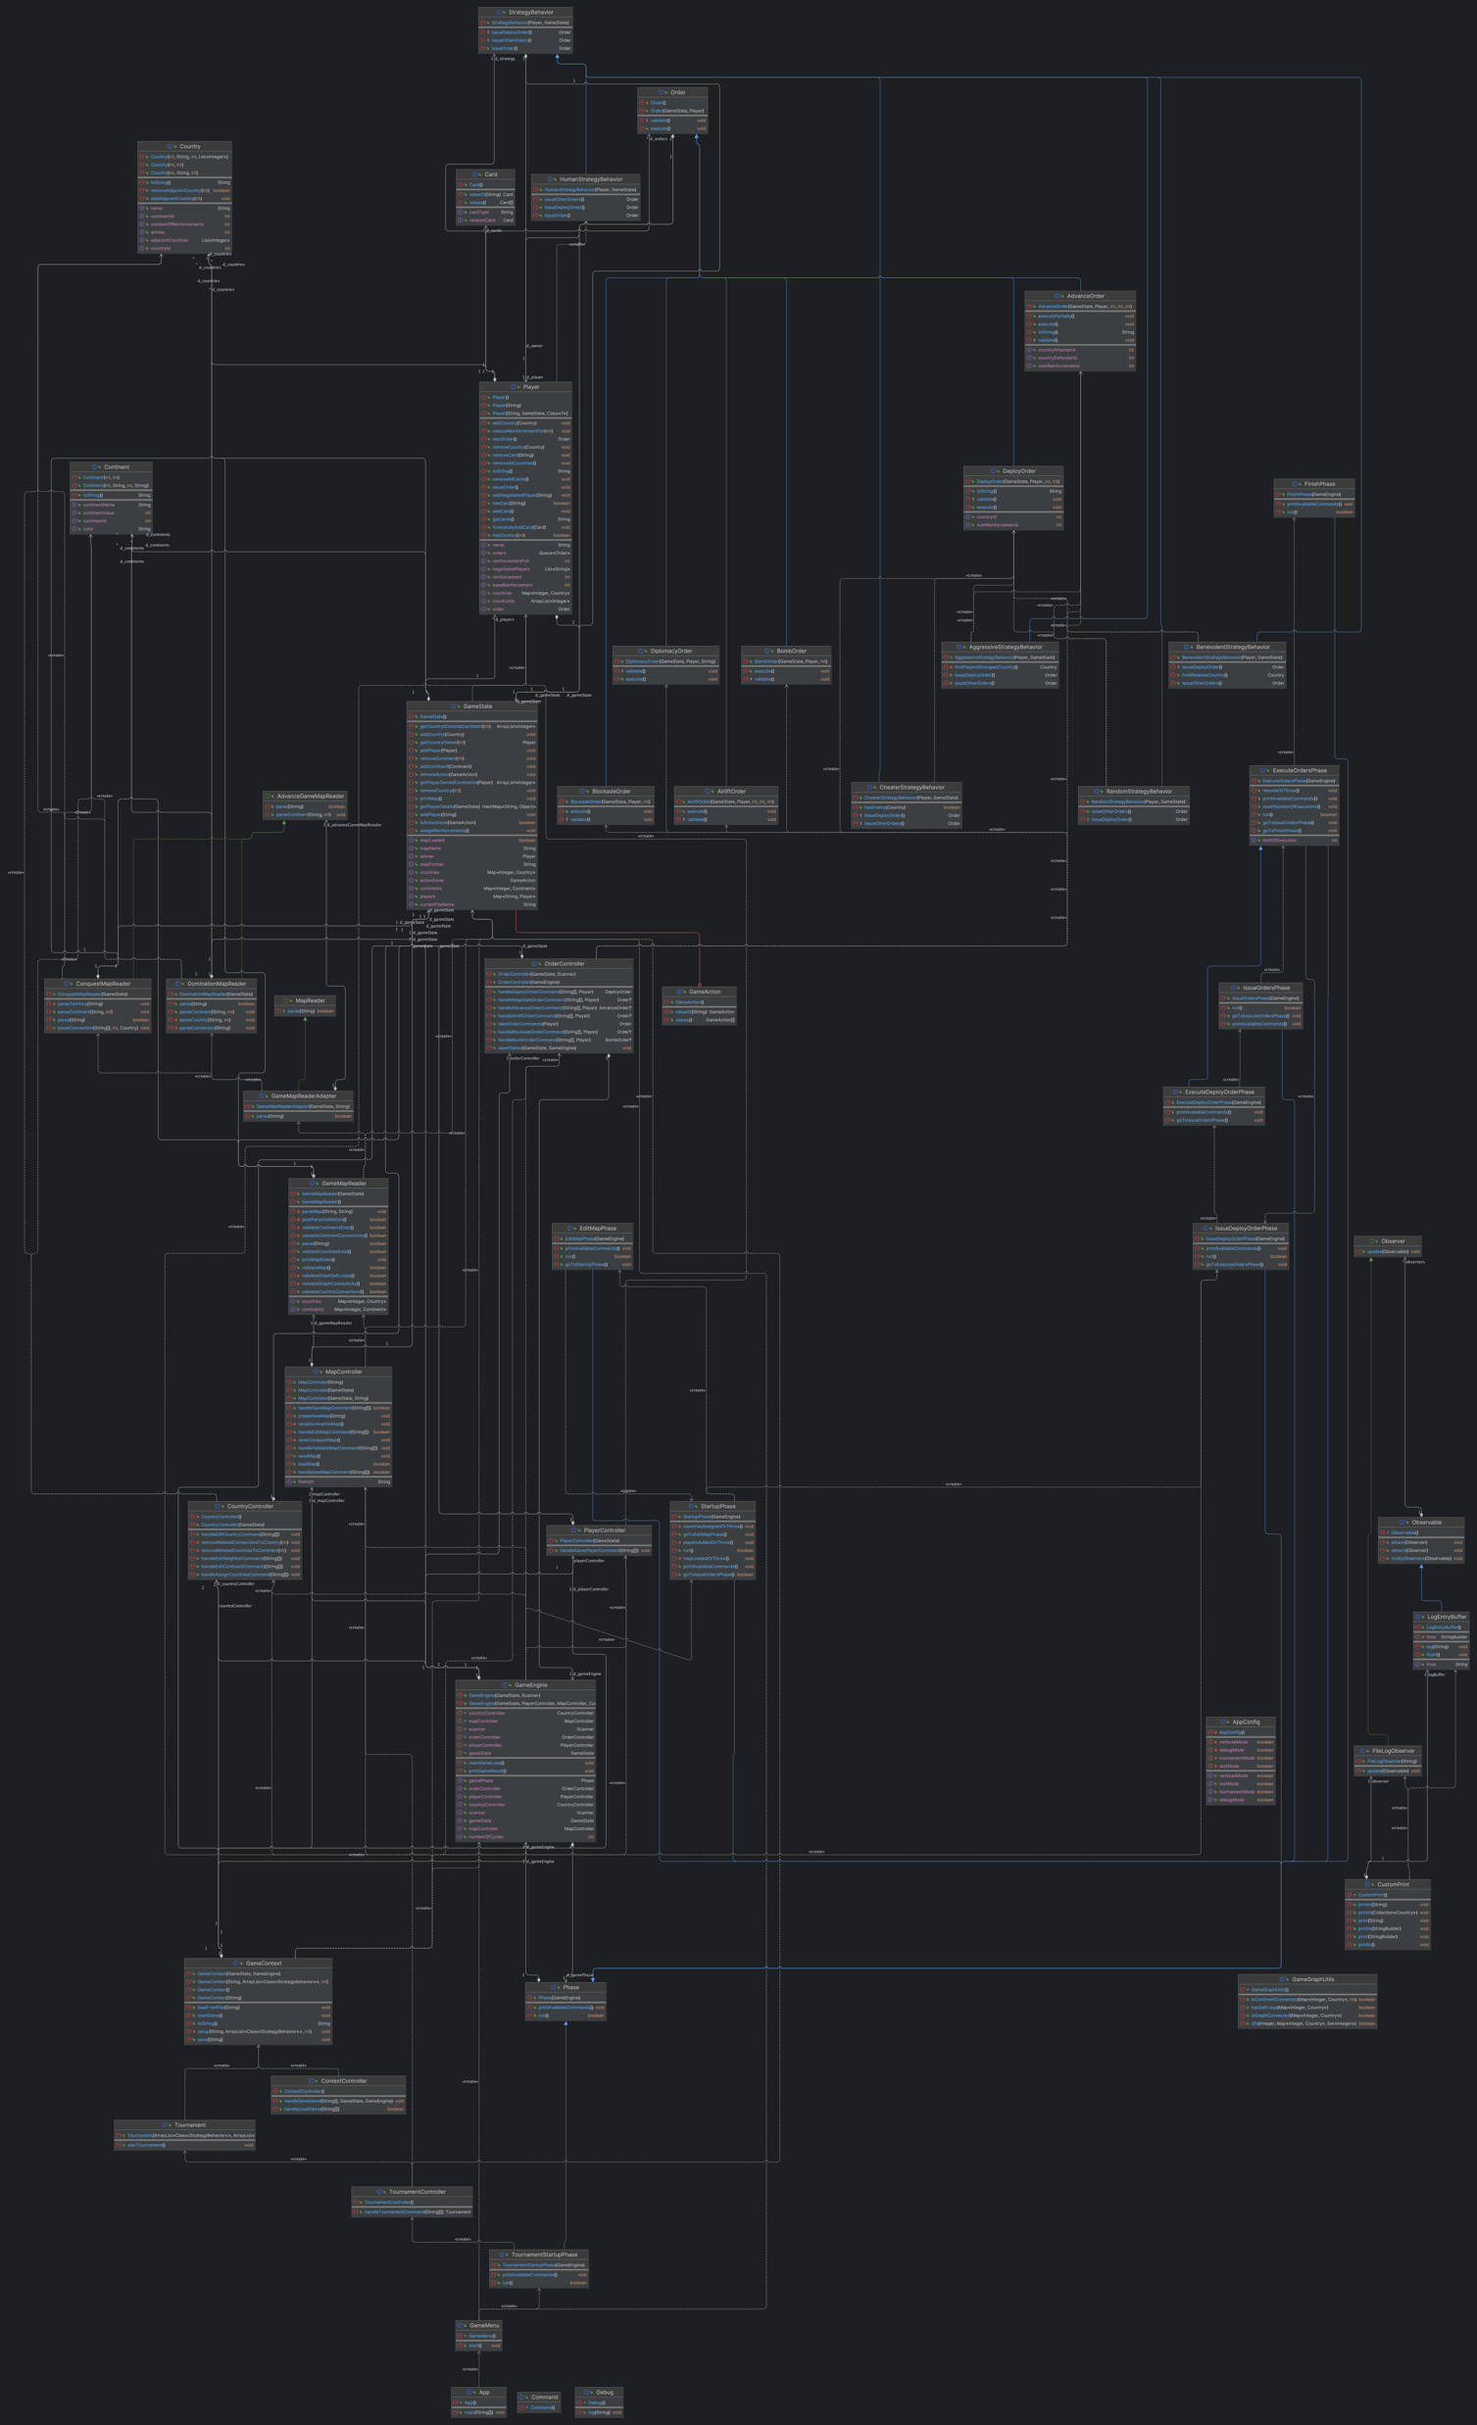

Slide 7
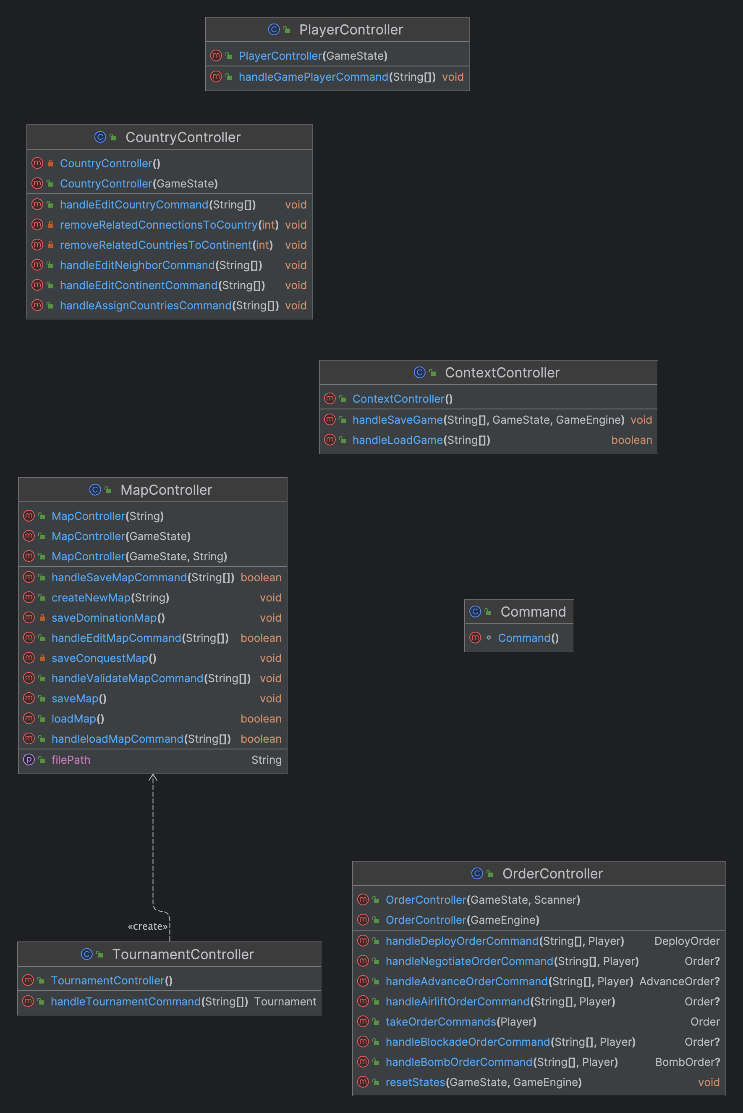

Slide 8
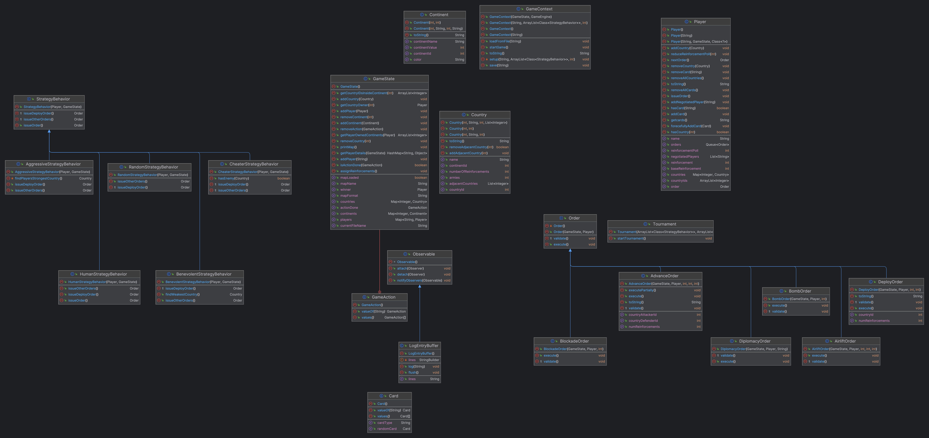

Slide 9
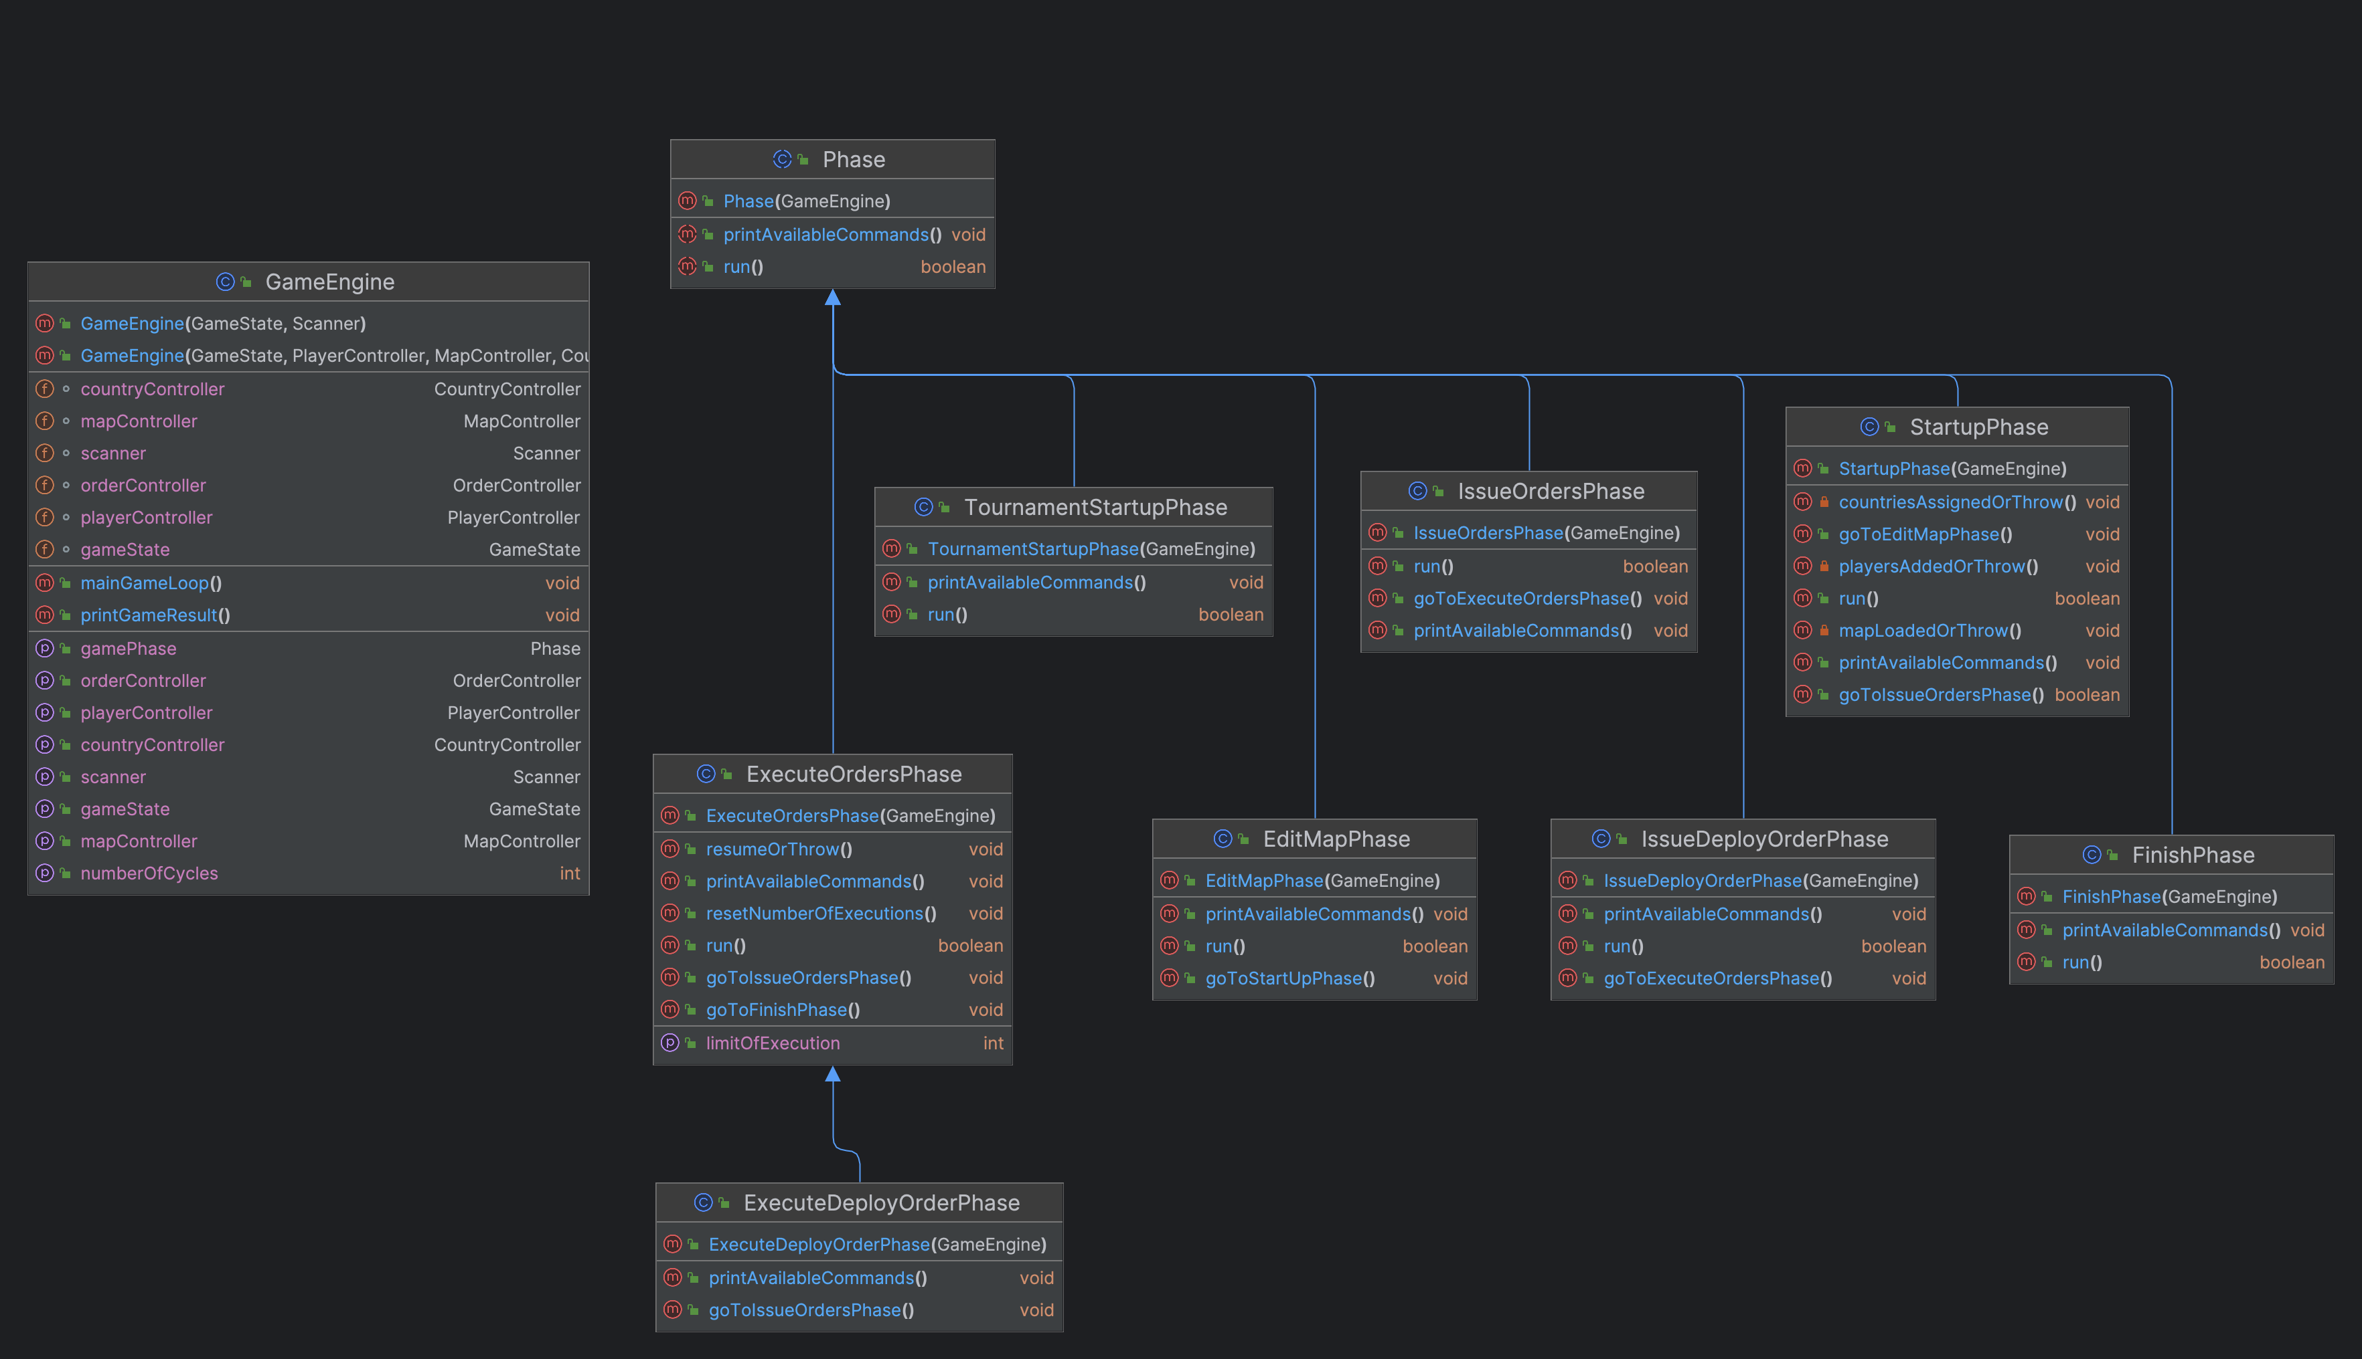

Slide 10
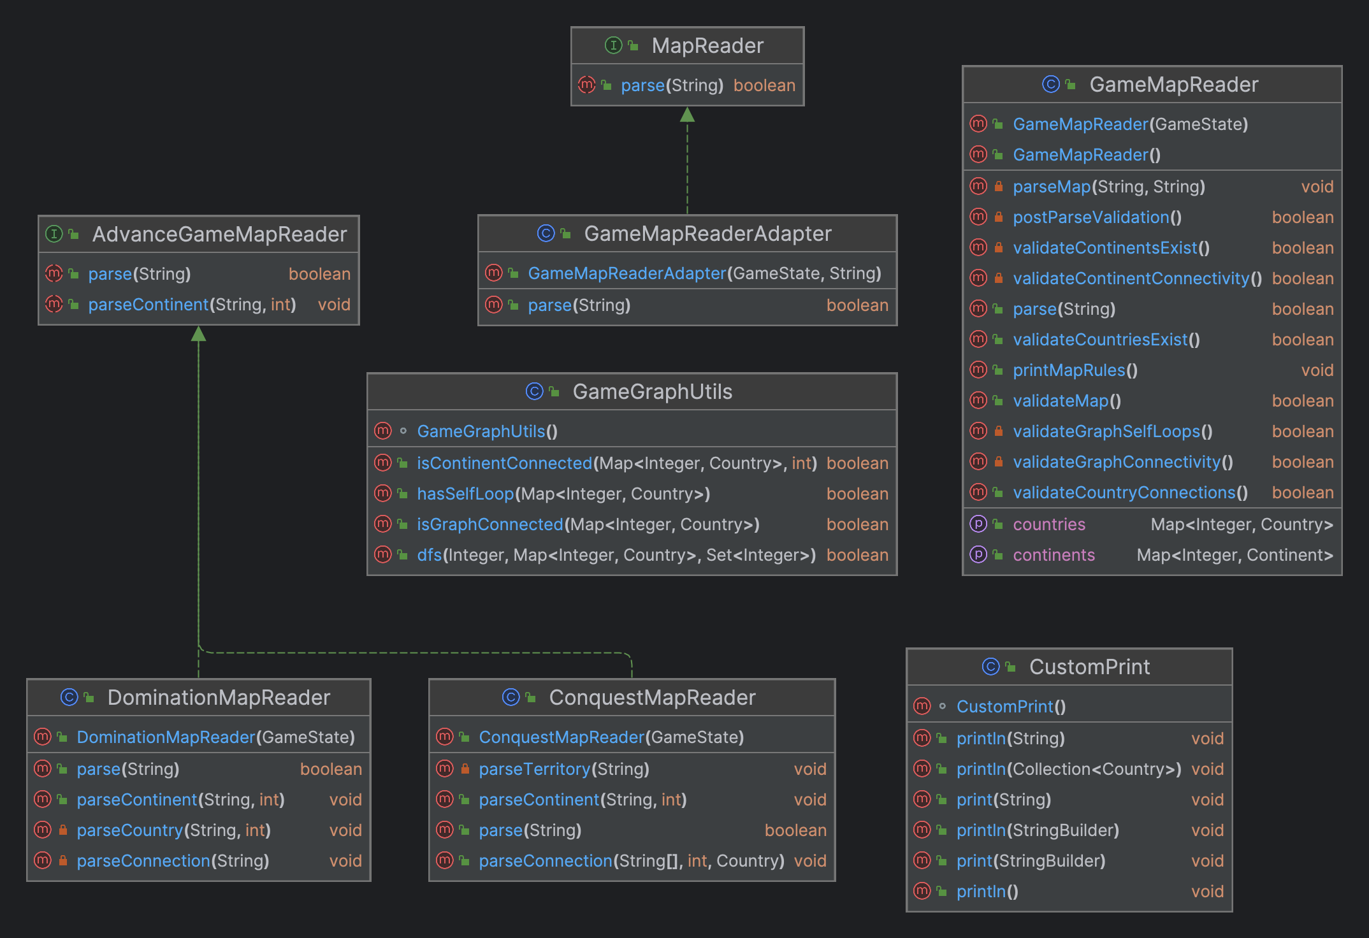

Slide 11
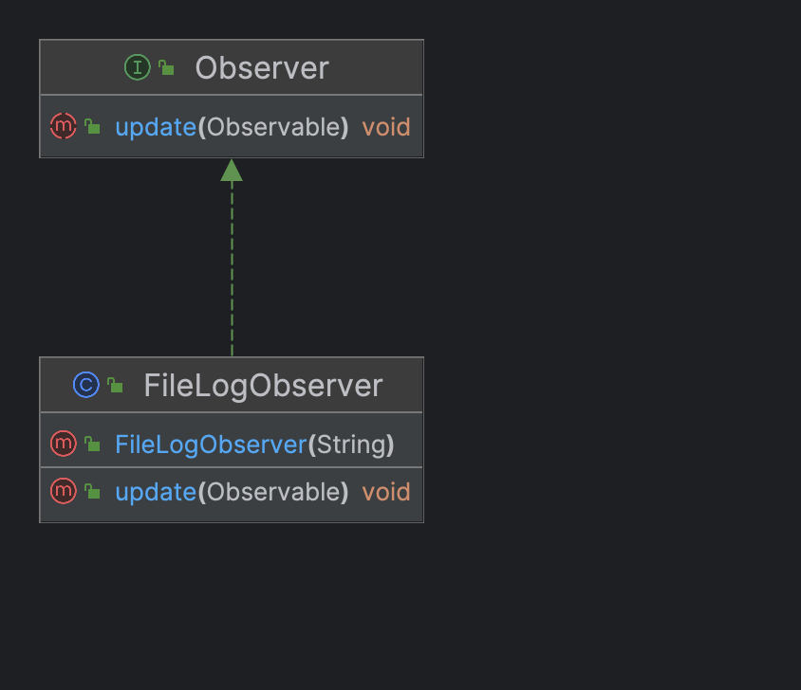

Slide 12
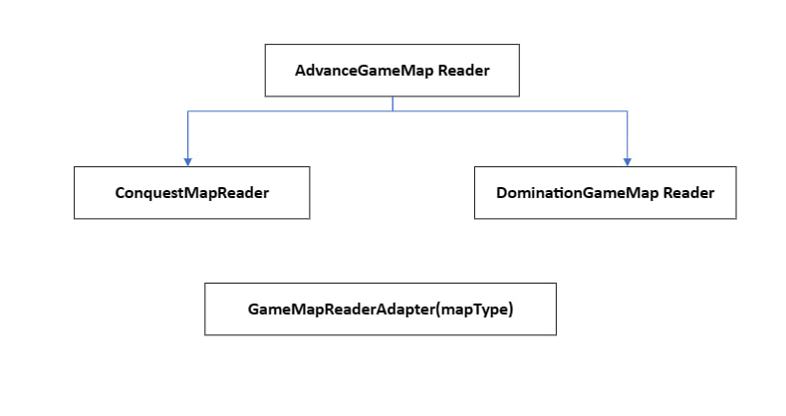

Slide 13
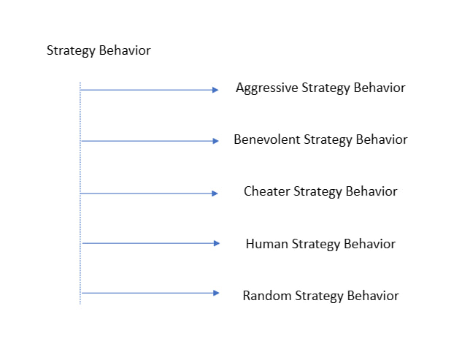

Slide 14
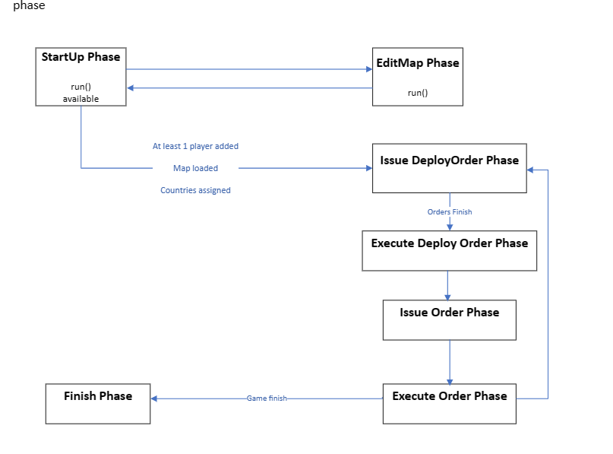

Slide 15
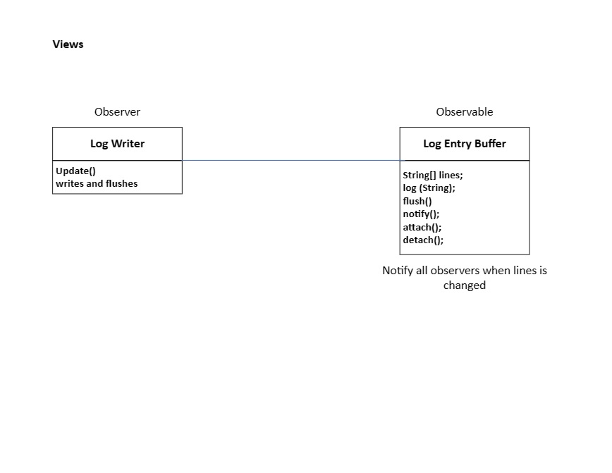

Slide 16
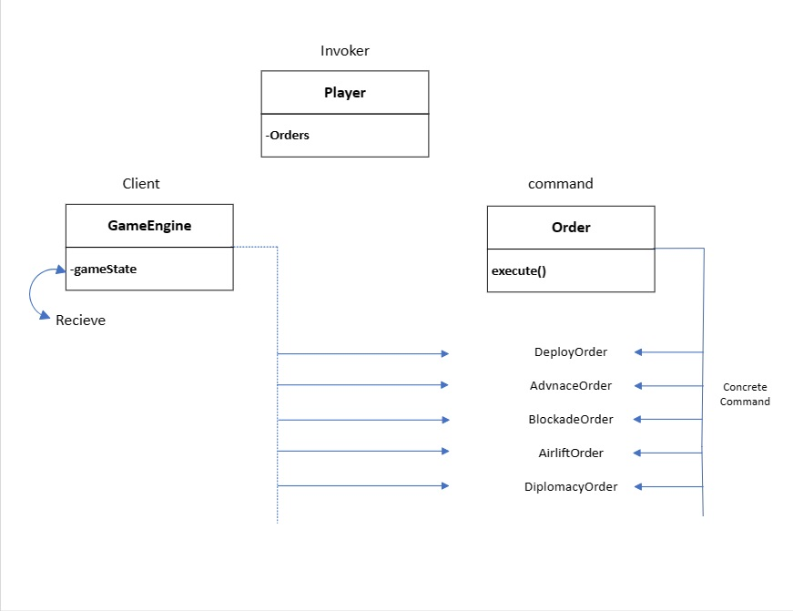

Slide 17
Code

Slide 18
Model
There are eleven classes in the Model:
1- Player
2- Continent
3- Country
4- Game State
9- Observable
6- Orders: deployOrder, AdvanceOrder, AirliftOrder, BombOrder, BlockadeOrder, DiplomacyOrder
7- Card
8- LogEntryBuffer
10- Behaviors: AggressiveStrategyBehavior, BenevolentStrategyBehavior, CheaterStrategyBehavior, HumanStrategyBehavior, RandomStrategyBehavior, StrategyBehavior
11- Tournament
5- Game Context

Slide 19
Player
the Player class encapsulates the state and behavior of a player in a game, including their name, countries owned, orders, reinforcements, cards, and strategy.
Instance variables:
d_name: A string representing the name of the player.
d_reinforcement: An integer representing the number of reinforcements the player has.
d_reinforcementPoll: An integer representing the number of reinforcements available for the player to use.
d_orders: A queue (FIFO) of Order objects representing the orders issued by the player.
d_countries: A map of integer keys (country IDs) to Country objects representing the countries owned by the player.
d_strategy: An instance of a class implementing the StrategyBehavior interface, representing the strategy behavior of the player.
d_gameState: An instance of the GameState class representing the game state.
d_negotiatedPlayers: A list of strings representing the names of players with whom the current player has negotiated.
d_cards: An ArrayList of Card objects representing the cards owned by the player.
d_cardFlag: A boolean flag indicating whether the player has already received a card in the current turn.
Constructors:
Player(): Default constructor.
Player(String p_name): Constructor that takes the player's name as a parameter and initializes the player's state.
Player(String p_name, GameState p_gameState, Class<?> p_startegy): Constructor that takes the player's name, game state, and a strategy class as parameters. It initializes the player's state and creates an instance of the strategy class for the player.

Slide 20
Player (Cont.)
Methods:
issueOrder(): This method is called during the "issue orders" phase of the game. It uses the player's strategy to generate an order and adds it to the list of orders.
setOrder(Order p_order): Adds a specified order to the list of orders.
nextOrder(): Retrieves and removes the next order from the list of orders.
Various getter and setter methods for accessing and modifying the player's name, reinforcement count, orders, countries owned, etc.
addCountry(Country p_country): Adds a country to the list of countries owned by the player.
removeCountry(Country p_country): Removes a country from the list of countries owned by the player.
addCard(): Adds a card to the player's collection if the "one card per turn" flag is not set.
forecefullyAddCard(Card p_card): Adds a card to the player's collection forcefully.
getcards(): Returns a string representation of the player's cards.
hasCard(String card): Checks if the player has a specific card.
removeCard(String bomb): Removes a specific card from the player's collection.
removeAllCards(): Removes all cards from the player's collection.
hasCountry(int p_CountryFromId): Checks if the player owns a specific country.
addNegotiatedPlayer(String p_PlayerToNegotiateWith): Adds a player to the list of negotiated players.
getNegotiatedPlayers(): Returns the list of negotiated players.

Slide 21
Continent
The Continent class provides a way to create and store information about a continent, including its ID, name, bonus value, and color. It also includes methods to access and modify these properties.
Instance variables:
d_id: An integer representing the ID of the continent.
d_value: An integer representing the bonus value of the continent.
d_name: A string representing the name of the continent.
d_color: A string representing the color of the continent.
Constructors:
Continent(int p_continentId, String p_continentName, int p_continentValue, String p_color): A constructor that takes the continent's ID, name, bonus value, and color as parameters. It initializes the corresponding instance variables.
Continent(int p_continentId, int p_continentValue): A constructor that takes the continent's ID and bonus value as parameters. It automatically sets the name to the ID and the color to "N/A".
Methods:
Getter methods such as getContinentId(), getContinentName(), getContinentValue(), and getColor() to retrieve the values of the instance variables.
setColor(String p_color): A method to set the color of the continent.
toString(): A method that returns a string representation of the Continent object, including the ID and bonus value.

Slide 22
Country
The Country class provides a way to create and store information about a country, including its ID, name, continent ID, adjacent countries, and number of reinforcements. It also includes methods to access and modify these properties.
Instance variables:
d_countryId: An integer representing the ID of the country.
d_countryName: A string representing the name of the country.
d_adjacentCountries: A list of integers representing the IDs of adjacent countries.
d_continentId: An integer representing the ID of the continent to which the country belongs.
d_numberOfReinforcements: An integer representing the number of reinforcements for the current round.
Constructors:
Country(int p_countryId, int p_continentId): A constructor that takes the country's ID and the continent's ID as parameters. It automatically generates the country name as the string representation of the country ID and initializes the adjacent countries list to an empty list.
Country(int p_countryId, String p_countryName, int p_continentId): A constructor that takes the country's ID, name, and the continent's ID as parameters. It initializes the adjacent countries list to an empty list.
Country(int p_countryId, String p_countryName, int p_continentId, List<Integer> p_adjacentCountries): A constructor that takes the country's ID, name, the continent's ID, and a list of adjacent country IDs as parameters. It initializes the corresponding instance variables.
Methods:
Getter and setter methods for the instance variables, such as getNumberOfReinforcements(), setNumberOfReinforcements(int p_reinforcements), getCountryId(), setCountryId(int p_countryId), getName(), setName(String p_countryName), getAdjacentCountries(), addAdjacentCountry(int p_adjacentCountryId), removeAdjacentCountry(int p_adjacentCountryId), getContinentId(), getArmies(), and setContinentId(int p_continentId).
toString(): A method that returns a string representation of the Country object, including the country's ID, name, and continent ID.

Slide 23
Game State
This class encapsulates the state of the game, provides methods to manipulate the game state, and facilitates operations such as adding players, managing continents and countries, assigning reinforcements, and providing game details.
Instance Variables:
d_currentTurn: An integer representing the current turn.
d_mapLoaded: A boolean indicating whether the game map is loaded.
d_players: A map of player names to Player objects.
d_continents: A map of continent IDs to Continent objects.
d_countries: A map of country IDs to Country objects.
d_currentFileName: A string representing the current file name.
Enums:
GameAction: An enum representing different game actions such as map loading, player addition, and country assignment.
Constructor:
Initializes instance variables.

Slide 24
Game State (Cont.)
Methods:
addPlayer(String p_name): Adds a player to the game with the given name.
addPlayer(Player player): Adds a player object to the game.
setActionDone(GameAction p_action): Sets a game action as done.
isActionDone(GameAction p_action): Checks if a game action is done.
removeAction(GameAction p_action): Removes a game action.
printMap(): Prints the map details including continents, countries, and their connections.
assignReinforcements(): Assigns reinforcements to players based on continents owned.
getPlayerOwnedContinents(Player p_player): Returns a list of continent IDs owned by the given player.
getCountryIDsInsideContinent(int p_continentID): Returns a list of country IDs within the given continent.
getCountryOwner(int p_countryId): Returns the player who owns the given country.
getPlayerDetails(GameState gameState): Returns details of players including reinforcements, cards, and countries owned.
removeCountry(int p_countryId): Removes a country from the game.
removeContinent(int p_continentId): Removes a continent from the game.
addContinent(Continent p_continent): Adds a continent to the game.
addCountry(Country p_country): Adds a country to the game.
Serialization:
Implements Serializable interface to support serialization of the GameState objects.

Slide 25
Game Context
the GameContext class provides functionality for managing the game state, setting up the game, and saving/loading game data.
The GameContext class is responsible for saving and loading game data, setting up the game, and starting the game.
The class contains instance variables such as d_gameState, d_playerController, d_mapController, d_countryController, and d_gameEngine, which are used to manage the game state and control the game flow.
The class has multiple constructors, each serving a different purpose. Some constructors take parameters such as d_gameState and d_gameEngine, while others initialize the instance variables with default values.
The setup method is used to configure the game by loading a map, setting up player behaviors, and assigning countries. It is primarily used in tournament mode.
The startGame method initiates the game by resetting execution counts, setting the game phase to issuing deploy orders, and starting the main game loop.
The class also includes methods for saving and loading the game context to/from a file using serialization.
The main method demonstrates the usage of the GameContext class by creating an instance, setting up the game, and saving/loading the game context.

Slide 26
Order
The Order class serves as a base class for different order types in a game.
It provides common functionality and requires subclasses to implement order-specific execution and validation.
The class has two instance variables:
d_gameState of type GameState, which represents the game state associated with the order.
d_owner of type Player, which represents the player who owns the order.
The constructor Order is a parameterized constructor that initializes the Order object. It takes a GameState object and a Player object as parameters. It assigns the values of the parameters to the corresponding instance variables. The constructor is marked as protected, indicating that it can only be called by subclasses.
The private no-argument constructor Order is used to prevent the creation of an Order object without a game state or owner. It sets the game state and owner variables to null.
The execute() method is an abstract method that must be overridden by subclasses. It represents the execution of the order and does not have an implementation in the Order class itself.
The validate() method is an abstract method that must be overridden by subclasses. It represents the validation of the order and does not have an implementation in the Order class itself.

Slide 27
Deploy Order
The DeployOrder class represents a specific type of order where reinforcements are deployed to a country owned by a player.
It extends the base Order class and provides its own implementation of the execute() and toString() methods.
All the details are explained in the bulid1 document.

Slide 28
Advance Order
The `AdvanceOrder` class represents an order to advance reinforcements from one country to another in a game.
- The class has several instance variables:
`d_countryAttackerId`: An integer representing the ID of the attacking country.
`d_countryDefenderId`: An integer representing the ID of the defending country.
`d_numReinforcements`: An integer representing the number of reinforcements to be advanced.
- The class defines two constants:
`ATTACKER_BEING_KILLED`: A constant representing the probability of an attacker being killed during a battle.
`DEFENDER_BEING_KILLED`: A constant representing the probability of a defender being killed during a battle.

Slide 29
Advance Order(Cont.)
The constructor AdvanceOrder initializes the AdvanceOrder object. It takes a GameState object, a Player object (the owner of the order), the IDs of the attacking and defending countries, and the number of reinforcements as parameters. The constructor calls the superclass constructor (Order) and assigns values to the instance variables. It then calls the validate() method to check the validity of the order.
The execute() method is overridden from the superclass. It performs the execution of the advance order. It retrieves the Country objects corresponding to the attacker and defender countries from the GameState. If the defender country is owned by the attacker, the method increases the number of reinforcements in the defender country and decreases the number of reinforcements in the attacker country. Otherwise, a battle occurs between the attacker and defender. The number of defending and attacking reinforcements are determined based on the available reinforcements. Random numbers are generated to determine the number of casualties for both the attacker and defender. The number of reinforcements in the defender country is updated based on the casualties. If the defender country has no reinforcements left and the attacker has remaining reinforcements, the defender country is captured by the attacker, and some additional actions are performed. Otherwise, the number of reinforcements in the attacker country is updated based on the remaining reinforcements.
The validate() method is overridden from the superclass. It validates the advance order to ensure that it is valid. It checks various conditions, such as whether the attacking country is owned by the player, whether the countries are adjacent, whether the number of reinforcements is non-negative, whether the countries exist, and whether the player is negotiated with the defender's owner.
The toString() method is overridden from the superclass. It returns a string representation of the advance order, including the owner, the number of reinforcements, and the IDs of the attacker and defender countries.

Slide 30
Airlift Order
The `Airlift` class represents an order to airlift reinforcements from one country to another in a game.
- The class has several instance variables:
- `d_countryFromId`: An integer representing the ID of the country from which the airlift is initiated.
- `d_countryToId`: An integer representing the ID of the country to which the airlift is directed.
- `d_numReinforcements`: An integer representing the number of reinforcements to be airlifted.
The constructor Airlift initializes the Airlift object. It takes a GameState object, a Player object (the owner of the order), the IDs of the "from" and "to" countries, and the number of reinforcements as parameters. The constructor calls the superclass constructor (Order) and assigns values to the instance variables. It then calls the validate() method to check the validity of the order.
The execute() method is overridden from the superclass. It performs the execution of the airlift order. It prints a message indicating the player's name, the number of reinforcements being airlifted, and the names of the "from" and "to" countries. The method then updates the number of reinforcements in both the "from" and "to" countries accordingly. Finally, it removes the "AIRLIFT" card from the player.
The validate() method is overridden from the superclass. It validates the airlift order to ensure that it is valid. It checks various conditions, such as whether the player has the "AIRLIFT" card, whether the player owns both the "from" and "to" countries, and whether the "from" country has enough reinforcements to airlift.

Slide 31
Blockade Order
The BlockadeOrder class represents a blockade order in a game. A blockade order triples the number of armies on one of the player’s own territories and converts it into a neutral territory.
The class has an instance variable l_countryId which represents the ID of the country on which the blockade order is to be executed.
The constructor BlockadeOrder initializes the BlockadeOrder object. It takes a GameState object, a Player object (the owner of the order), and the ID of the country as parameters. The constructor calls the superclass constructor (Order) and assigns values to the instance variables. It then calls the validate() method to check the validity of the order.
The execute() method is overridden from the superclass. It performs the execution of the blockade order. It prints a message indicating the player's name and the name of the country being blockaded. The method then triples the number of armies on the country by setting its number of reinforcements to three times its current value. It creates a new neutral player in the game and assigns the blockaded country to the neutral player. Finally, it removes the country from the current player and removes the "BLOCKADE" card from the player.
The validate() method is overridden from the superclass. It validates the blockade order to ensure that it is valid. It checks whether the player has the "BLOCKADE" card and whether the country is owned by the player. If any of these conditions are not met, an IllegalArgumentException is thrown.
Overall, the BlockadeOrder class represents a blockade order in a game. It provides methods to execute the order, validate its validity, and perform the necessary actions such as tripling the number of armies on a player's territory, converting it into a neutral territory, and updating the game state accordingly.

Slide 32
Bomb Order
The BombOrder class represents a bomb order in a game. A bomb order destroys half of the armies located on an opponent's territory.
The class has an instance variable l_countryId which represents the ID of the country on which the bomb order is to be executed.
The constructor BombOrder initializes the BombOrder object. It takes a GameState object, a Player object (the owner of the order), and the ID of the country as parameters. The constructor calls the superclass constructor (Order) and assigns values to the instance variables. It then calls the validate() method to check the validity of the order.
The execute() method is overridden from the superclass. It performs the execution of the bomb order. It prints a message indicating the player's name, the name of the country being bombed, and the owner of the country. The method then destroys half of the armies on the country by setting its number of reinforcements to half of its current value (rounded down). Finally, it removes the "BOMB" card from the player.
The validate() method is overridden from the superclass. It validates the bomb order to ensure that it is valid. It checks whether the player owns the country and whether the player has the "BOMB" card. If any of these conditions are not met, an IllegalArgumentException is thrown.
Overall, the BombOrder class represents a bomb order in a game. It provides methods to execute the order, validate its validity, and perform the necessary actions such as destroying half of the armies on an opponent's territory and updating the game state accordingly.

Slide 33
Diplomacy Order
The DiplomacyOrder class represents a diplomacy order in a game. A diplomacy order allows a player to negotiate with another player.
The class has an instance variable d_playerToNegotiateWith which represents the name of the player to negotiate with.
The constructor DiplomacyOrder initializes the DiplomacyOrder object. It takes a GameState object, a Player object (the owner of the order), and the name of the player to negotiate with as parameters. The constructor calls the superclass constructor (Order) and assigns values to the instance variables. It then calls the validate() method to check the validity of the order.
The execute() method is overridden from the superclass. It performs the execution of the diplomacy order. It prints a message indicating the player's name and the name of the player being negotiated with. The method then removes the "NEGOTIATE" card from the player and adds the player to negotiate with to the negotiated players list of the owner player. It also adds the owner player to the negotiated players list of the player to negotiate with. Finally, it removes the "NEGOTIATE" card from the player to negotiate with.
The validate() method is overridden from the superclass. It validates the diplomacy order to ensure that it is valid. It checks whether the player has the "NEGOTIATE" card, whether the player to negotiate with exists in the game, and whether the player to negotiate with is not the owner player. If any of these conditions are not met, an IllegalArgumentException is thrown.
Overall, the DiplomacyOrder class represents a diplomacy order in a game. It provides methods to execute the order, validate its validity, and perform the necessary actions such as removing the "NEGOTIATE" card from the player, adding players to the negotiated players list, and updating the game state accordingly.

Slide 34
Card
The code implements an enumeration (enum) called Card, which represents different types of cards in a game.
Here's an explanation of the code:
The Card enum defines four card types: BOMB, BLOCKADE, AIRLIFT, and NEGOTIATE. These types represent different abilities or actions that can be associated with game cards.
The getRandomCard() method is used to retrieve a random card type from the available card types. It uses the values() method of the enum to get an array of all possible card types and selects a random element from that array.
The getCardType() method is used to retrieve the name of a specific card type as a String. It uses the name() method of the enum to get the name of the card type.
Each card type (BOMB, BLOCKADE, AIRLIFT, and NEGOTIATE) is automatically assigned an ordinal value based on its position in the enum declaration. The first card type, BOMB, has an ordinal value of 0, BLOCKADE has an ordinal value of 1, and so on.
The enum provides a convenient way to represent a fixed set of related constants (in this case, different card types) in a type-safe manner. It ensures that only valid card types can be used in the code.

Slide 35
LogEntryBuffer
The `LogEntryBuffer` class extends the `Observable` class, which suggests that it is intended to be used in the Observer design pattern.
The class has a private instance variable called `lines`, which is a `StringBuilder` used to store log entries.
The `getLines()` method returns the log entries stored in the `lines` variable as a `String`.
The `log(String action)` method is used to add a new log entry to the buffer. It appends the `action` parameter to the `lines` variable, followed by a newline character (`\n`). After adding the entry, it notifies the observers (if any) by calling `notifyObservers(this)`. Finally, it calls the `flush()` method.
The `flush()` method is used to clear the log entries by creating a new `StringBuilder` instance and assigning it to the `lines` variable. This effectively clears the stored log entries.
Overall, the `LogEntryBuffer` class provides a simple mechanism for storing log entries in a buffer. It allows adding new log entries, retrieving the stored entries, and clearing the buffer. By extending the `Observable` class, it also allows other classes to observe changes in the log entries and be notified when new entries are added.

Slide 36
Observable
The `Observable` class is a custom implementation of the observer pattern.
The class has a private instance variable called `observers`, which is a list of `Observer` objects. This list is used to keep track of the views that are observing (or subscribed to) the `Observable`.
The `attach(Observer p_o)` method is used to attach a view (`Observer`) to the `Observable`. It adds the specified `Observer` object to the list of observers by calling `observers.add(p_o)`.
The `detach(Observer p_o)` method is used to detach a view (`Observer`) from the `Observable`. It removes the specified `Observer` object from the list of observers by calling `observers.remove(p_o)`.
The `notifyObservers(Observable p_o)` method is used to notify all the attached observers (views) that a change has occurred in the `Observable`. It calls the `update()` method on each observer, passing the `Observable` object as a parameter.
The `update(Observable p_o)` method is not shown in the provided code. It is assumed to be part of the `Observer` interface or superclass, and it is expected to be implemented by the views (observers) to handle the updates from the `Observable`.
Overall, the `Observable` class provides a basic implementation of the observer pattern. It allows views (observers) to attach to and detach from the `Observable`, and it provides a mechanism to notify the attached observers of changes in the `Observable`.

Slide 37
Behaviors Using Strategy Pattern
The Strategy pattern is a behavioral design pattern that allows you to define a family of algorithms, encapsulate each one as a separate class, and make them interchangeable at runtime. It enables the client code to choose a specific algorithm implementation dynamically without being tightly coupled to it.
In the code, the Strategy pattern is used to implement different strategies for player behavior in a game. The StrategyBehavior abstract class serves as the base class for different strategy behaviors, and each concrete strategy behavior (such as HumanStrategyBehavior, RandomStrategyBehavior, etc.) extends this base class and provides its own implementation for the abstract methods.
The StrategyBehavior class defines the common structure and behavior for all strategy behaviors. It includes the issueOrder method, which acts as the common entry point for issuing orders based on the implemented strategy. This method determines the current game phase and calls the appropriate strategy-specific methods (issueDeployOrder or issueOtherOrders) based on the phase.
Subclasses, such as HumanStrategyBehavior and RandomStrategyBehavior, provide their own implementations for the issueDeployOrder and issueOtherOrders methods, which represent the specific logic for issuing deploy orders and other orders according to the respective strategies.
By using the Strategy pattern, the game can dynamically switch between different strategy behaviors during runtime. The behavior of a player can be changed simply by associating a different concrete strategy behavior with the player object. This decoupling of the player's behavior from the game logic allows for flexibility and extensibility in defining and modifying strategies without modifying the core game code.

Slide 38
StrategyBehavior
The StrategyBehavior class provides a common structure and behavior for different strategy behaviors in a game. Subclasses of this class, such as HumanStrategyBehavior and RandomStrategyBehavior, implement the specific strategies by providing implementations for the issueOtherOrders and issueDeployOrder methods.
Here's an explanation of the code:
Import statements: The code includes import statements for various classes and packages required for the functionality of the StrategyBehavior class. These include OrderController, GameState, Player, Order, and IssueDeployOrder.
Class declaration: The StrategyBehavior class is declared as an abstract class.
Member variables: The class includes two member variables:
d_player: Represents the player that is using the behavior.
d_gameState: Represents the game state.
STR_TO_BEHAVIOR map: This is a static map that maps strings to different strategy behavior classes. It is used to convert a string representation of a behavior into the corresponding behavior class. The map includes mappings for behaviors such as "human," "aggressive," "benevolent," "random," and "cheater."
Constructor: The class includes a constructor for the StrategyBehavior class. The constructor takes a Player object and a GameState object as parameters and initializes the d_player and d_gameState member variables.
issueOrder method: This method is responsible for issuing orders based on the implemented strategy. It first checks if the player owns any countries. If the player does not own any countries, it returns null to indicate that no order can be issued. It then checks the current game phase using the OrderController.d_gameEngine.getGamePhase() method. If the game phase is an instance of IssueDeployOrder, it calls the issueDeployOrder method. Otherwise, it calls the issueOtherOrders method. The method returns an Order object representing the issued order.
issueOtherOrders method: This method is declared as an abstract method and is responsible for issuing orders other than deploy orders based on the implemented strategy. Subclasses of StrategyBehavior must provide an implementation for this method.
issueDeployOrder method: This method is declared as an abstract method and is responsible for issuing a deploy order based on the implemented strategy. Subclasses of StrategyBehavior must provide an implementation for this method.

Slide 39
AggressiveStrategyBehavior
The AggressiveStrategyBehavior class implements an aggressive strategy for a player in a game. The strategy involves attacking with the player's strongest country and maximizing the aggregation of forces in one country. If there are enemy countries adjacent to the strongest country, it attacks the weakest adjacent enemy country. Otherwise, it advances to the next strongest neighbor. The class provides methods to issue other orders and deploy orders based on this strategy. Here's an explanation of the code:
Import statements: The code imports several classes and packages that are required for the functionality of the AggressiveStrategyBehavior class. These include Country, GameState, Player, and various order-related classes. These classes are defined in other files or packages and are needed to be imported for their usage in this class.
Class declaration: The AggressiveStrategyBehavior class is declared and extends the StrategyBehavior class. It inherits the behavior of the parent class and overrides its methods.
Constructor: The code includes a constructor for the AggressiveStrategyBehavior class. The constructor takes a Player object and a GameState object as parameters and passes them to the parent class constructor using the super keyword.
issueOtherOrders method: This method is overridden from the parent class. It represents the logic for issuing orders based on an aggressive strategy. The method checks if the player's strongest country has adjacent enemy countries. If there are enemy neighbors, it issues an AdvanceOrder to attack the weakest adjacent enemy country. If there are no enemy neighbors, it issues an AdvanceOrder to reinforce the strongest adjacent friendly country.
issueDeployOrder method: This method is also overridden from the parent class. It represents the logic for issuing a deploy order. The method finds the player's strongest country using the findPlayersStrongestCountry method and issues a DeployOrder to deploy reinforcements to that country.
findPlayersStrongestCountry method: This private method finds the strongest country owned by the player. It iterates over the player’s countries and compares the number of reinforcements of each country to find the one with the maximum reinforcements.

Slide 40
BenevolentStrategyBehavior
The BenevolentStrategyBehavior class implements the Benevolent strategy for a player in a game. The strategy focuses on reinforcing the weakest countries and prioritizes strengthening vulnerable areas. The class provides methods to issue other orders and deploy orders based on this strategy.
Import statements: The code includes import statements for various classes and packages required for the functionality of the BenevolentStrategyBehavior class. These include Country, GameState, Player, and different order-related classes.
Class declaration: The BenevolentStrategyBehavior class is declared and extends the StrategyBehavior class. It inherits the behavior of the parent class and overrides its methods.
Constructor: The code includes a constructor for the BenevolentStrategyBehavior class. The constructor takes a Player object and a GameState object as parameters and passes them to the parent class constructor using the super keyword.
issueOtherOrders method: This method is overridden from the parent class. It represents the logic for issuing other orders based on the Benevolent strategy. The method identifies the weakest country owned by the player using the findWeakestCountry method. Then, it looks for adjacent countries that are owned by the player and have the most reinforcements. It prioritizes reinforcing vulnerable areas. If such a country is found, it issues an AdvanceOrder to move reinforcements from the strong adjacent country to the weakest country. If no suitable country is found, it returns null.
issueDeployOrder method: This method is overridden from the parent class. It represents the logic for issuing a deploy order. The method finds the weakest country owned by the player using the findWeakestCountry method and issues a DeployOrder to deploy all available reinforcements to that country.
findWeakestCountry method: This method finds the weakest country owned by the player. It iterates over the player’s countries and compares the number of reinforcements of each country to find the one with the minimum reinforcements.

Slide 41
CheaterStrategyBehavior
The CheaterStrategyBehavior class implements the Cheater strategy for a player in a game. The strategy focuses on conquering all enemy neighboring countries and doubling the number of armies in countries with enemy neighbors. The class provides methods to issue other orders and deploy orders based on this strategy.
Here's an explanation of the code:
Import statements: The code includes import statements for various classes and packages required for the functionality of the CheaterStrategyBehavior class. These include Country, GameState, Player, and different order-related classes.
Class declaration: The CheaterStrategyBehavior class is declared and extends the StrategyBehavior class. It inherits the behavior of the parent class and overrides its methods.
Constructor: The code includes a constructor for the CheaterStrategyBehavior class. The constructor takes a Player object and a GameState object as parameters and passes them to the parent class constructor using the super keyword.
issueOtherOrders method: This method is overridden from the parent class. It represents the logic for issuing other orders based on the Cheater strategy. The method iterates over the countries owned by the cheater player and checks for enemy neighboring countries. If an enemy neighboring country is found, the cheater player conquers it by removing it from the defender's ownership and adding it to their own. Additionally, the number of armies in the cheater player's countries with enemy neighbors is doubled. The method doesn't return any order in this implementation.
hasEnemy method: This method checks whether a given country has an enemy in its neighboring countries. It iterates over the adjacent countries of the given country and checks if the neighboring country is owned by an opponent player. If such a neighboring country is found, it returns true, indicating the presence of an enemy. Otherwise, it returns false.
issueDeployOrder method: This method is overridden from the parent class. It represents the logic for issuing a deploy order. In this implementation, the cheater player does not deploy reinforcements. Instead, it selects a random country from its owned countries and deploys all available reinforcements to that country using a DeployOrder.

Slide 42
HumanStrategyBehavior
The HumanStrategyBehavior class implements the behavior for a human player in a game. It relies on the OrderController to handle the process of taking input commands from the human player and creating order objects. The class provides methods to issue other orders and deploy orders based on the input received from the human player.
Here's an explanation of the code:
Import statements: The code includes import statements for various classes and packages required for the functionality of the HumanStrategyBehavior class. These include Country, GameState, Player, Order, and OrderController.
Class declaration: The HumanStrategyBehavior class is declared and extends the StrategyBehavior class. It inherits the behavior of the parent class and overrides its methods.
Constructor: The code includes a constructor for the HumanStrategyBehavior class. The constructor takes a Player object and a GameState object as parameters and passes them to the parent class constructor using the super keyword.
issueOtherOrders method: This method is overridden from the parent class. It represents the logic for issuing other orders. In this implementation, it calls the issueOrder method to handle the order issuing process and returns the order obtained from that method.
issueDeployOrder method: This method is overridden from the parent class. It represents the logic for issuing a deploy order. In this implementation, it also calls the issueOrder method to handle the order issuing process and returns the order obtained from that method.
issueOrder method: This method represents the logic for issuing an order. It enters a while loop that continues indefinitely until a valid order is obtained. Inside the loop, it checks if the player owns any countries. If the player does not own any countries, it returns null to indicate that no order can be issued. Otherwise, it calls the takeOrderCommands method of the OrderController class, passing the player as a parameter. This method is responsible for taking input commands from the human player and creating an order object based on those commands. If a non-null order is obtained from the takeOrderCommands method, it is returned. Otherwise, the loop continues and another attempt is made to obtain a valid order.

Slide 43
RandomStrategyBehavior
The RandomStrategyBehavior class implements the random strategy for a computer player in a game. The strategy involves randomly selecting a country owned by the player and issuing an advance order to one of its adjacent countries with a random number of armies. It also randomly selects one of the player's countries and deploys a random number of armies to that country. The class provides methods to issue other orders and deploy orders based on this strategy.
Here's an explanation of the code:
Import statements: The code includes import statements for various classes and packages required for the functionality of the RandomStrategyBehavior class. These include Country, GameState, Player, and different order-related classes.
Class declaration: The RandomStrategyBehavior class is declared and extends the StrategyBehavior class. It inherits the behavior of the parent class and overrides its methods.
Random object: The code includes a Random object named rand to generate random numbers. This is used to make random choices during the strategy execution.
Constructor: The code includes a constructor for the RandomStrategyBehavior class. The constructor takes a Player object and a GameState object as parameters and passes them to the parent class constructor using the super keyword.
issueOtherOrders method: This method is overridden from the parent class. It represents the logic for issuing other orders based on the random strategy. In this implementation, it randomly selects a country owned by the player and one of its adjacent countries. It then creates and returns an AdvanceOrder object with the random player country ID, random adjacent country ID, and the player’s reinforcement pool.
issueDeployOrder method: This method is overridden from the parent class. It represents the logic for issuing a deploy order based on the random strategy. In this implementation, it randomly selects one of the player's countries and deploys a random number of armies to that country. It creates and returns a DeployOrder object with the game state, player, random player country ID, and the player’s reinforcement pool.

Slide 44
Tournament
This class is responsible for organizing and running a tournament between different strategies in multiple games on different maps.
Instance Variables:
d_mapPaths: An ArrayList of String objects representing the paths to the maps on which the tournament will be played.
d_behaviors: An ArrayList of Class objects that extend the StrategyBehavior class, representing the different strategies participating in the tournament.
d_numberOfGames: An integer representing the number of games to be played in the tournament.
d_numberOfTurns: An integer representing the maximum number of turns allowed in each game.
Constructor:
Tournament(ArrayList<Class<? extends StrategyBehavior>> p_behaviors, ArrayList<String> p_mapPaths, int p_numberOfGames, int p_numberOfTurns): A constructor for the Tournament class. It takes the lists of strategy behaviors, map paths, number of games, and number of turns as parameters and initializes the instance variables accordingly.
Public Methods:
startTournament(): This method starts the tournament. It iterates over each map path in the d_mapPaths list and for each map, it runs the specified number of games. For each game, it creates a GameContext object with the map path, list of strategy behaviors, and number of turns, and then calls the startGame() method to begin the game.
main Method:
The main method demonstrates an example usage of the Tournament class. It creates an ArrayList of strategy behaviors (behaviors) and adds two strategies (CheaterStrategyBehavior and HumanStrategyBehavior) to the list. It also creates an ArrayList of map paths (mapPaths) and adds a single map path ("canada.map") to the list. Finally, it creates a Tournament object with the lists of behaviors and map paths, and the specified number of games and turns, and calls the startTournament() method to begin the tournament.

Slide 45
Controller
There are six classes in the Controller:
1- Command
2- Country Controller
3- Map Controller
4- Order Controller
5- Play Controller
6- Tournament Controller

Slide 46
Command
The Command class provides a centralized location for defining and accessing all the commands and their syntax used in the game. This helps in maintaining consistency and clarity throughout the codebase.
Constants:
Constants for each command, such as SHOW_MAP, VALIDATE_MAP, ASSIGN_COUNTRIES, etc. These constants represent the command names.
Constants for command syntax, such as GAME_PLAYER_SYNTAX, ASSIGN_COUNTRIES_SYNTAX, DEPLOY_SYNTAX, etc. These constants represent the syntax for each command.
Command Categories:
Basic game commands, such as map manipulation (SHOW_MAP, VALIDATE_MAP, ASSIGN_COUNTRIES).
Editing commands for continents, countries, and neighbors (EDIT_CONTINENT, EDIT_COUNTRY, EDIT_NEIGHBOR).
Commands for saving and loading maps (SAVE_MAP, EDIT_MAP, LOAD_MAP).
Player-related commands (GAME_PLAYER, DEPLOY, ADVANCE).
Special actions like BOMB, BLOCKADE, AIRLIFT, and NEGOTIATE.
Tournament Commands: Commands related to conducting tournaments, including options for maps, player strategies, number of games, and maximum turns.
Save and Load Game Commands:
Commands for saving and loading the game state, with corresponding syntax.

Slide 47
Country Controller
The CountryController class provides functionalities to manage countries, continents, and their relationships effectively in the game, ensuring proper assignment, editing, and removal operations are performed under the game rules.
Instance Variables:
d_gameState: Represents the current state of the game.
Constructor:
CountryController(GameState p_gameState): Initializes the CountryController with the provided GameState.
Methods:
handleAssignCountriesCommand(String[] p_args): Handles the assignment of countries to players. It verifies that players are added and a valid map is loaded before proceeding. It shuffles the countries and assigns them to players one by one.
handleEditNeighborCommand(String[] p_args): Handles editing of neighboring countries. It adds or removes connections between countries based on the provided arguments.
handleEditCountryCommand(String[] p_args): Handles editing of countries. It adds or removes countries from the game map based on the provided arguments.
handleEditContinentCommand(String[] p_args): Handles editing of continents. It adds or removes continents from the game map based on the provided arguments.
removeRelatedCountriesToContinent(int continentID): Removes countries related to a continent being removed and removes connections to those countries.
removeRelatedConnectionsToCountry(int countryID): Removes connections related to a country being removed.
Error Handling:
Each method handles errors gracefully by catching exceptions and printing error messages using CustomPrint.println.
Dependencies:
This class depends on other classes such as GameState, Country, Continent, CustomPrint, and Command.

Slide 48
Map Controller
The MapController provides functionalities to manage game maps effectively, ensuring proper parsing, validation, editing, and saving of map files in a robust and error-tolerant manner.
Instance Variables:
d_gameMapReader: An instance of GameMapReader used for parsing and validating map files.
d_gameState: An instance of GameState representing the current state of the game.
d_filePath: The file path of the map file.
Constructors:
Three constructors are provided:
One constructor takes a GameState and a file path as arguments.
Another constructor takes only a GameState.
The third constructor takes only a file path.
Methods:
getFilePath(): Returns the file path of the map file.
handleValidateMapCommand(String[] p_args): Validates the loaded map. Prints whether the map is valid or invalid.
handleEditMapCommand(String[] p_args): Handles the edit map command, either by loading an existing map or creating a new one.
handleSaveMapCommand(String[] p_args): Handles the save map command by saving the map to the specified file path.
saveMap(): Saves the map to a file.
createNewMap(String p_filePath): Creates a new map file.
loadMap(): Loads the game map file and validates it. Returns true if the map is valid, false otherwise.
handleloadMapCommand(String[] p_args): Handles the load map command by parsing and loading the map file.
Dependencies:
This class depends on other classes such as GameState, GameMapReader, CustomPrint, and Command.
Error Handling:
The methods handle errors such as invalid number of arguments, file not found, map validation failure, and I/O errors gracefully by catching exceptions and printing error messages.

Slide 49
Order Controller
The OrderController class serves as a central component for processing order commands in the game, ensuring proper execution and validation of orders based on the current game state and phase.
Instance Variables:
d_gameState: Represents the current state of the game.
d_scanner: A Scanner object used for taking input.
d_gameEngine: Represents the game engine.
Methods:
resetStates(GameState p_gameState, GameEngine p_gameEngine): Resets the states of the OrderController.
Constructors:
OrderController(GameState p_gameState, Scanner p_scanner): Initializes the OrderController with a game state and a scanner object.
OrderController(GameEngine p_gameEngine): Initializes the OrderController with a game engine.
takeOrderCommands(Player p_ownerPlayer): Takes order commands from the player. It handles different types of orders based on the current game phase.
Order Handling Methods:
Methods to handle specific order commands such as handleDeployOrderCommand, handleAdvanceOrderCommand, handleBombOrderCommand, handleBlockadeOrderCommand, handleAirliftOrderCommand, and handleNegotiateOrderCommand.
Each of these methods parses the command arguments and creates corresponding order objects (DeployOrder, AdvanceOrder, BombOrder, BlockadeOrder, AirliftOrder, DiplomacyOrder).
These methods also perform input validation and error handling.
Command Execution:
The takeOrderCommands method reads user input and executes the appropriate order handling method based on the command entered.
It also handles special commands such as exit, showmap, savegame, and loadgame.
Static Methods:
Most methods in the OrderController class are static, allowing them to be accessed without creating an instance of the class.
This design facilitates the handling of orders without the need to instantiate multiple OrderController objects.

Slide 50
Player Controller
The PlayerController encapsulates the logic for handling player-related commands, ensuring that players can be added or removed from the game state correctly and maintaining consistency with the overall game state.
Instance Variables:
gameState: An instance of the GameState class representing the current state of the game.
Constructor:
Initializes the PlayerController with a GameState object.
Method handleGamePlayerCommand(String[] p_args):
This method processes commands related to adding or removing players from the game.
It expects an array of strings p_args containing the command arguments.
It retrieves the map of players from the game state.
It iterates over the command arguments, processing them in pairs (option and player name).
For each pair, it checks the command option (add or remove) and performs the corresponding action.
If adding a player, it checks if the player already exists, creates a new player object, adds it to the player map, and updates the game state accordingly.
If removing a player, it checks if the player exists, removes it from the player map, and updates the game state if needed.
If any errors occur during processing, it catches exceptions and prints error messages.
It ensures that the number of arguments is valid and follows the correct syntax for player-related commands.
Dependencies:
This class depends on other classes such as GameState, Player, HumanStrategyBehavior, CustomPrint, and Command from the respective packages.

Slide 51
Tournament Controller
The TournamentController serves as an intermediary between the user interface (commands) and the tournament-related functionalities provided by the underlying models. It encapsulates the logic for parsing and validating tournament commands, ensuring proper execution and error handling.
Method handleTournamentCommand(String[] p_args):
This method parses and processes tournament-related commands.
It expects an array of strings p_args containing the command and its arguments.
Inside the method, it initializes several local variables to store tournament-related parameters.
It checks if the number of arguments is sufficient for processing the command.
It iterates over the arguments array to parse different options such as maps, players, games, and turns.
For each option, it extracts relevant information and performs validation checks.
It instantiates a Tournament object with the parsed parameters if the parsing and validation are successful.
If any error occurs during parsing or validation, it prints an error message indicating the correct syntax.
Finally, it returns the Tournament object if successfully created, otherwise returns null.
Instance Variables:
There are no instance variables defined in this snippet, but the method utilizes local variables to store tournament-related parameters.
Dependencies:
This class depends on other classes such as GameState, StrategyBehavior, and Tournament from the models package, as well as MapController and Command for handling map-related operations and storing command syntax, respectively.

Slide 52
Context Controller
The ContextController acts as a bridge between user commands related to game loading and saving and the underlying game logic encapsulated in GameContext. It provides a layer of abstraction to handle these operations cleanly and efficiently.
Method handleLoadGame(String[] p_args):
This method handles the command to load a game.
It expects an array of strings as arguments.
It initializes a GameContext object with the provided file name.
It then starts the game using the startGame() method of GameContext.
If successful, it returns true, otherwise catches and prints any exceptions and returns false.
Method handleSaveGame(String[] p_args, GameState p_gameState, GameEngine p_gameEngine):
This method handles the command to save the game.
It expects an array of strings containing the file name to save.
Additionally, it requires the current game state (GameState object) and the game engine (GameEngine object).
It initializes a GameContext object with the provided game state and game engine.
It then invokes the save() method of GameContext to save the game state and game engine into the specified file.
If an exception occurs, it prints the stack trace and the error message.

Slide 53
Services
There are eight classes in the Services:
1- MapReader
2- AdvanceGameMapReader
3- GameMapReaderAdapter
4- ConquestMapReader
5- DominationMapReader
6- GameMapReader
7-GameGraphUtils
8-CustomPrint

Slide 54
Map Reader
MapReader serves as the target interface for the adapter pattern.
parse Method:
This method is used to parse a file.
It takes a file path as a parameter and returns a boolean value indicating whether the file was parsed successfully.
The method throws an IOException if there is an error in reading the file.
Overall, the MapReader interface defines a contract for classes that can parse a file. Classes implementing this interface should provide an implementation for the parse method, which takes a file path and returns a boolean value indicating the success of the parsing operation.

Slide 55
AdvanceGameMapReader
AdvanceGameMapReader acts as the adaptee interface for the adapter pattern.
Interface Methods: The interface defines two methods: parse and parseContinent.
parse method: This method takes a file path as a parameter and is used to parse the file. It returns a boolean value indicating the success or failure of the parsing operation. It throws an exception if there is an error in reading the file.
parseContinent method: This method takes a line and a continent count as parameters. It is used to parse a continent from the given line. The specific implementation details of this method are not provided in the interface.
The purpose of this interface is to define the contract for parsing a game map file and extracting continent information. It acts as the adaptee interface, meaning it represents an existing service or component that needs to be adapted to work with a different interface or client.

Slide 56
GameMapReaderAdapter
GameMapReaderAdapter serves as an adapter between the MapReader interface and the AdvanceGameMapReader interface. This class allows you to use different implementations of the AdvanceGameMapReader interface based on the map type specified.
Class Variable:
d_advanceGameMapReader: An instance of the AdvanceGameMapReader interface.
Constructor:
The class has a constructor that takes a GameState object and a map type as parameters.
Depending on the map type ("Conquest" or "Domination"), the constructor creates an instance of the corresponding AdvanceGameMapReader implementation (ConquestMapReader or DominationMapReader) and assigns it to the d_advanceGameMapReader variable.
parse Method:
This method is an implementation of the parse method defined in the MapReader interface.
The method delegates the parsing operation to the d_advanceGameMapReader object by calling its parse method with the provided file.
If an exception occurs during the parsing operation, the method catches the exception, prints the stack trace, and returns false.

Slide 57
ConquestMapReader
ConquestMapReader that implements the AdvanceGameMapReader interface. This class is responsible for reading and parsing a conquest map file.
Class Variables:
d_gameState: An instance of the GameState class.
d_continents: A map that stores continent objects, where the key is the continent ID.
d_countries: A map that stores country objects, where the key is the country ID.
Constructor:
The class has a constructor that takes a GameState object as a parameter. The constructor initializes the d_gameState, d_continents, and d_countries variables.
parse Method:
This method is an implementation of the parse method defined in the AdvanceGameMapReader interface. It takes a file path as a parameter and returns a boolean value indicating whether the file was parsed successfully.
The method reads the file line by line and checks for specific sections indicated by [Continents] and [Territories].
If the line indicates a continent section, the method calls the parseContinent method to parse the continent details.
If the line indicates a territory section, the method calls the parseTerritory method to parse the territory details.
parseContinent Method:
This method is an implementation of the parseContinent method defined in the AdvanceGameMapReader interface. It takes a line and a continent count as parameters.
The method parses the line to extract the continent name and bonus, and creates a new Continent object using the extracted information. The Continent object is then stored in the d_continents map.

Slide 58
ConquestMapReader (Cont.)
parseTerritory Method:
This method is used to parse the details of a territory from a line.
The method splits the line using commas and extracts the territory name and continent name.
It searches for the corresponding continent ID based on the continent name using the d_continents map.
If the territory already exists in the d_countries map, its continent ID is updated. Otherwise, a new Country object is created and added to the d_countries map.
The method also calls the parseConnection method to parse any adjacent territories.
parseConnection Method:
This method is used to parse the connections (adjacent territories) of a territory.
It iterates over the parts of the line starting from index 4, which contain the names of adjacent territories.
For each adjacent territory name, it checks if the territory already exists in the d_countries map.
If the adjacent territory exists, its ID is retrieved and added to the adjacent countries of the current territory.
If the adjacent territory does not exist, a new Country object is created, added to the d_countries map, and its ID is added to the adjacent countries of the current territory.
Overall, the ConquestMapReader class provides an implementation of the AdvanceGameMapReader interface to parse a conquest map file and populate the d_continents and d_countries maps in the GameState object.

Slide 59
DominationMapReader
DominationMapReader implements the AdvanceGameMapReader interface. This class is used to read a domination map file.
parse Method:
This method is an implementation of the parse method defined in the AdvanceGameMapReader interface. However, the implementation in this class simply returns false, indicating that the file parsing was not successful. The method does not perform any actual parsing of the file.
parseContinent Method:
This method is an implementation of the parseContinent method defined in the AdvanceGameMapReader interface. However, the implementation in this class is empty and does not contain any parsing logic for continents.
Overall, the DominationMapReader class is a placeholder implementation that does not perform any actual parsing of the domination map file. It returns false for the parse method and does not parse continents in the parseContinent method.

Slide 60
GameMapReader
This class represents a GameMapReader class in a game application. This class is responsible for reading and parsing a game map file, which contains information about continents, countries, and their connections.
Class Variables:
d_gameState: An instance of the GameState class that represents the current state of the game.
d_continents: A map that stores continent objects, where the key is the continent ID.
d_countries: A map that stores country objects, where the key is the country ID.
Constructors:
GameMapReader(GameState p_gameState): A constructor that initializes the GameMapReader with a given GameState object.
GameMapReader(): A default constructor that initializes the GameMapReader with a new GameState object and empty continent and country maps.
Public Methods:
getContinents(): Returns the continents map.
getCountries(): Returns the countries map.
parse(String p_filePath): Parses the game map file located at the given file path. It reads the file line by line and populates the continents, countries, and their connections. It also validates the map after parsing and returns true if the map is valid, false otherwise.
Private Methods:
parseContinent(String p_line, int p_continentCount): Parses a line representing a continent and adds it to the continents map.
parseCountry(String p_line, int p_countryCount): Parses a line representing a country and adds it to the countries map.
parseConnection(String p_line): Parses a line representing the connections of a country and adds the connections to the corresponding country object.
printMapRules(): Prints the rules for a valid game map.
validateMap(): Validates the parsed game map by checking various conditions, such as the presence of continents, countries, connections, and the overall connectivity of the map.
The code also includes a method parseConquest(String p_filePath) that is called when a conquest map is detected. This method uses a GameMapReaderAdapter to parse the conquest map file and populate the game state accordingly.

Slide 61
GameGraphUtils
The GameGraphUtils class is primarily used to check the connectivity of the game map graph, both at the overall graph level and the continent level. It also provides a method to detect self-loops, which are not desirable in the game map.
Constructors:
GameGraphUtils(): A constructor for the GameGraphUtils class. It is empty and does not perform any initialization.
Public Methods:
isGraphConnected(Map<Integer, Country> p_countries): Checks if the graph formed by the countries is connected. It uses Depth-First Search (DFS) to explore the graph and keeps track of visited countries. If the number of visited countries is equal to the total number of countries, it means the graph is connected, and the method returns true.
isContinentConnected(Map<Integer, Country> p_countries, int p_continentId): Checks if the continent formed by the countries with the given continent ID is connected. It also uses DFS to explore the continent and keeps track of visited countries. If the number of visited countries in the continent is equal to the total number of countries in the continent, it means the continent is connected, and the method returns true.
dfs(Integer p_countryId, Map<Integer, Country> p_countries, Set<Integer> p_visited): Performs a Depth-First Search (DFS) on the graph. It starts from the country with the given country ID and explores its adjacent countries recursively. It marks visited countries in the p_visited set.
hasSelfLoop(Map<Integer, Country> p_countries): Checks if the graph has a self-loop. It iterates over each country and checks if its adjacent countries contain its own ID. If a self-loop is found, the method prints a message and returns true.

Slide 62
CustomPrint
The CustomPrint class provides convenient methods to print output to the console and log the output to a file. By using these methods, the application can maintain a log of events and messages for debugging or record-keeping purposes.
Constructors:
CustomPrint(): A constructor for the CustomPrint class. It is empty and does not perform any initialization.
Static Variables:
logBuffer: An instance of the LogEntryBuffer class to buffer log entries.
observer: An instance of the FileLogObserver class to observe and write log entries to a file.
Static Block:
A static block is used to initialize the logBuffer and observer objects. It creates a new LogEntryBuffer and FileLogObserver and attaches the observer to the buffer. It also logs a message indicating that the game has started.
Public Methods:
println(): Prints an empty line to the console and logs an empty string to the file.
println(String pString): Prints the given string to the console and logs the string to the file.
print(String pString): Prints the given string to the console without appending a newline character and logs the string to the file.
println(StringBuilder outputString): Prints the contents of the StringBuilder object to the console and logs the string to the file.
print(StringBuilder outputString): Prints the contents of the StringBuilder object to the console without appending a newline character and logs the string to the file.

Slide 63
Phases
There are ten classes in the Service:
2- StartUpPhase
7- ExecuteOrderPhase
8- EditMapPhase
5- ExecuteDeployOrderPhase
6- IssueOrderPhase
1- Phase
10- GameEngine
3- TournamentStartupPhase
4- IssueDeployOrderPhase
9- FishPhase

Slide 64
Phase Using State Pattern
The State pattern is a behavioral design pattern that allows an object to alter its behavior when its internal state changes. It encapsulates distinct behaviors into separate state classes and delegates the behavior to the current state. This pattern promotes loose coupling and simplifies code maintenance and extensibility by avoiding conditional statements that depend on the object's state.
The Phase class serves as the base class for different phases in the game. Each concrete phase class represents a specific state of the game. For example, IssueDeployOrder, Reinforcement, and Attack can be considered different states of the game.
The Phase class includes an abstract run method, which represents the main logic of the phase. Each concrete phase class must provide its own implementation for this method, defining the behavior to be executed in that particular phase. This separation of behavior into different classes allows each phase to encapsulate its own state-specific logic.
The Phase class also includes an abstract printAvailableCommands method. This method is responsible for printing the available commands specific to the current phase. By delegating the responsibility of printing available commands to each phase, the code adheres to the principle of encapsulating behavior within specific states.
Different phases represent different states of the game, and each phase class encapsulates its own behavior and prints available commands specific to that phase. This separation of behavior based on the current phase can be seen as a form of state pattern usage.

Slide 65
Phase
The Phase class provides a common structure and behavior for different phases in a game. Subclasses of this class, such as IssueDeployOrder, Reinforcement, Attack, etc., extend this base class and provide their own implementations for the abstract methods.
By using the Phase class hierarchy, the game can define and manage different phases of gameplay. Each phase is responsible for specific tasks and behaviors, and the game engine can transition between phases as the game progresses. The abstract nature of the Phase class allows for flexibility in defining new phases and customizing the behavior of each phase.
Here's an explanation of the code:
Class declaration: The Phase class is declared as an abstract class.
Member variable: The class includes a single member variable:
d_gameEngine: Represents the game engine associated with the phase.
Constructor: The class includes a constructor for the Phase class. The constructor takes a GameEngine object as a parameter and assigns it to the d_gameEngine member variable.
printAvailableCommands method: This method is declared as an abstract method and is responsible for printing the available commands specific to the phase. Subclasses of Phase must provide an implementation for this method.
run method: This method is declared as an abstract method and represents the main logic of the phase. It is responsible for running the phase, which may involve tasks such as getting user input, executing commands, and updating the game state. The method returns a boolean value indicating whether the phase should continue or not. Subclasses of Phase must provide an implementation for this method.

Slide 66
StartUp Phase
The StartupPhase class represents a specific state in the game's lifecycle. It encapsulates the behavior and actions specific to the startup phase, providing a modular and extensible structure for managing different game phases.
Inheritance: The StartupPhase class extends the Phase abstract class, indicating that it represents a specific phase or state of the game.
Override Methods: The StartupPhase class overrides the printAvailableCommands and run methods inherited from the Phase class. These methods define the behavior specific to the startup phase.
printAvailableCommands method: This method prints the available commands for the startup phase. It displays a list of commands, such as setting game players, loading maps, editing maps, assigning countries, loading a saved game, proceeding to the next phase, or exiting the game.
run method: This method represents the main logic of the startup phase. It reads user input, processes commands, and performs appropriate actions based on the input. It uses a switch statement to handle different commands entered by the user and delegates the command processing to the corresponding controllers (e.g., getPlayerController, getMapController, getCountryController, ContextController).
Transition to EditMapPhase: The goToEditMapPhase method transitions the game from the startup phase to the edit map phase. It creates an instance of the EditMapPhase class (which represents the next state or phase) and sets it as the current game phase using the game engine.
Transition to IssueDeployOrder: The goToIssueOrdersPhase method facilitates the transition from the startup phase to the issue orders phase. It performs some checks to ensure that the map is loaded, players are added, and countries are assigned. If these conditions are met, it assigns reinforcements, sets the game phase to the IssueDeployOrder phase, and returns true. Otherwise, it returns false and displays an error message.

Slide 67
TournamentStartup Phase
The TournamentStartupPhase class represents a specific state in the game where a tournament is being set up. It implements the necessary behavior and actions specific to this phase.
Inheritance: The TournamentStartupPhase class extends the Phase abstract class, indicating that it represents a specific phase or state of the game.
Override Methods: The TournamentStartupPhase class overrides the printAvailableCommands and run methods inherited from the Phase class. These methods define the behavior specific to the tournament startup phase.
printAvailableCommands method: This method prints the available commands for the tournament startup phase. In this case, it only displays the command for starting a tournament.
run method: This method represents the main logic of the tournament startup phase. It reads user input, processes the tournament command, and performs appropriate actions based on the input.
Tournament Controller: The TournamentController class is instantiated within the run method. It is responsible for handling tournament-related commands and actions.
Tournament Command: The run method checks if the user input starts with the tournament command (Command.TOURNAMENT). If it does, the TournamentController is invoked to handle the tournament command.
Tournament Start: If the TournamentController successfully handles the tournament command and returns a valid Tournament object, the startTournament method is called on that object to initiate the tournament.
Exit: Since the return value of the run method is always false, the execution will not exit the game or transition to another phase after the tournament startup phase is completed.

Slide 68
IssueDeployOrder Phase
The IssueDeployOrder class is responsible for managing the issue deploy orders phase of the game.
Inheritance: The IssueDeployOrder class extends the Phase abstract class, indicating that it represents a specific phase or state of the game.
Override Methods: The IssueDeployOrder class overrides the printAvailableCommands and runs methods inherited from the Phase class. These methods define the behavior specific to the issue deploy orders phase.
printAvailableCommands method: This method prints the available commands for the issue deploy orders phase. It provides information about the phase, available commands (e.g., deploying reinforcements), and the current number of reinforcements each player has.
run method: This method represents the main logic of the issue deploy orders phase. It initializes a map of players' order status, where each player is initially set to not have finished issuing orders. The method then enters a game loop where each player takes turns issuing orders until all players have finished. Once all players have finished ordering, it proceeds to the execute orders phase by invoking the goToExecuteOrdersPhase method.
goToExecuteOrdersPhase method: This method facilitates the transition from the issue deploy orders phase to the execute orders phase. It creates an instance of the ExecuteDeployOrderPhase class (which represents the next state or phase) and sets it as the current game phase using the game engine.

Slide 69
ExecuteDeployOrder Phase
The ExecuteDeployOrderPhase class is responsible for managing the execute deploy order phase of the game.
Inheritance: The ExecuteDeployOrderPhase class extends the ExecuteOrdersPhase class, which in turn extends the Phase abstract class. This indicates that the ExecuteDeployOrderPhase represents a specific phase or state of the game, inheriting behavior from both ExecuteOrdersPhase and Phase.
Override Methods: The ExecuteDeployOrderPhase class overrides the printAvailableCommands and goToIssueOrdersPhase methods inherited from the Phase and ExecuteOrdersPhase classes, respectively. These methods define the behavior specific to the execute deploy order phase.
printAvailableCommands method: This method prints the available commands for the execute deploy order phase. It provides information about the phase but does not list any specific commands.
goToIssueOrdersPhase method: This method facilitates the transition from the execute deploy order phase to the issue orders phase. It attempts to resume the game or throws an exception if an error occurs. If the game can be resumed, it creates an instance of the IssueOrdersPhase class (which represents the next state or phase) and sets it as the current game phase using the game engine. If an exception occurs, it prints the error message and proceeds to the finish phase.

Slide 70
IssueOrder Phase
The IssueOrdersPhase class is responsible for managing the issue orders phase of the game.
Inheritance: The IssueOrdersPhase class extends the Phase abstract class, indicating that it represents a specific phase or state of the game.
Constructor: The class has a constructor that takes a GameEngine object and calls the superclass constructor to initialize the game engine.
Override Methods: The IssueOrdersPhase class overrides the printAvailableCommands and run methods inherited from the Phase class. These methods define the behavior specific to the issue orders phase.
printAvailableCommands method: This method prints the available commands for the issue orders phase. In tournament mode, it only prints the phase name. In regular mode, it adds additional information about available commands, such as typing 'exit' to exit the game.
run method: This method represents the main logic of the issue orders phase. It starts by printing available commands. It then initializes a map of players' order status, where each player is initially set to not have finished issuing orders. The method enters a game loop where each player takes turns issuing orders until all players have finished. After a player issues their orders, the method checks if the player has any remaining reinforcements or countries to issue orders for. If they do, it prompts the player to deploy the remaining reinforcements. If the player has no remaining reinforcements or countries, it marks them as finished issuing orders. Once all players have finished ordering, it proceeds to the execute orders phase by invoking the goToExecuteOrdersPhase method.
goToExecuteOrdersPhase method: This method facilitates the transition from the issue orders phase to the execute orders phase. It creates an instance of the ExecuteOrdersPhase class (which represents the next state or phase) and sets it as the current game phase using the game engine.

Slide 71
ExecuteOrder Phase
The ExecuteOrdersPhase class is responsible for managing the execute orders phase of the game.
Inheritance: The ExecuteOrdersPhase class extends the Phase abstract class, indicating that it represents a specific phase or state of the game.
Constructor: The class has a constructor that takes a GameEngine object and calls the superclass constructor to initialize the game engine. It also logs a debug message.
Override Methods: The ExecuteOrdersPhase class overrides the printAvailableCommands and run methods inherited from the Phase class. These methods define the behavior specific to the execute orders phase.
printAvailableCommands method: This method prints the available commands for the execute orders phase. In tournament mode, it only prints the phase name. In regular mode, it indicates that orders are being executed.
run method: This method represents the main logic of the execute orders phase. It starts by printing available commands. It enters a game loop where each player takes turns executing their orders until no orders are left to execute. For each player, it retrieves the next order from their order list and executes it. After executing all orders, it prints the players' countries and their armies. It then increments the execution count, and proceeds to the issue orders phase by invoking the goToIssueOrdersPhase method.
resumeOrThrow method: This method is responsible for checking if any player has won the game or if the execution limit has been reached. If a player has won, it throws an exception with a message indicating the winner. If the execution limit has been reached, it throws an exception with a message Indicating that the execution limit has been reached.
goToFinishPhase method: This method facilitates the transition from the execute orders phase to the finish phase. It creates an instance of the FinishPhase class (which represents the next state or phase) and sets it as the current game phase using the game engine.
goToIssueOrdersPhase method: This method facilitates the transition from the execute orders phase to the issue orders phase. It first calls the resumeOrThrow method to check if a player has won or if the execution limit has been reached. If not, it assigns reinforcements to the players and sets the game phase to the IssueDeployOrder phase (assuming this is a custom phase not shown in the code). If a player has won or the execution limit has been reached, it prints an appropriate message and proceeds to the finish phase using the goToFinishPhase method.
resetNumberOfExecutions method: This is a static method that resets the execution count to zero. It can be used to reset the count between game sessions.
setLimitOfExecution method: This is a static method that sets the execution limit to a specified value. It allows customizing the execution limit as needed.

Slide 72
EditMapPhase
The EditMapPhase class is responsible for managing the map edit phase of the game.
Inheritance: The EditMapPhase class extends the Phase abstract class, indicating that it represents a specific phase or state of the game.
Constructor: The class has a constructor that takes a GameEngine object and calls the superclass constructor to initialize the game engine.
Override Methods: The EditMapPhase class overrides the printAvailableCommands and run methods inherited from the Phase class. These methods define the behavior specific to the map edit phase.
printAvailableCommands method: This method prints the available commands for the map edit phase. It uses the CustomPrint service to display a list of commands related to editing the map, validating the map, saving the map, and showing the map. It also indicates that the user can type 'exit' to exit the game.
run method: This method represents the main logic of the map edit phase. It starts by printing the available commands using the printAvailableCommands method. It then enters a loop where it prompts the user for input, parses the input into a command and arguments, and executes the corresponding command using the appropriate controller methods. The method supports commands such as editing continents, editing countries, editing neighbors, validating the map, saving the map, showing the map, and proceeding to the next phase. If the user types 'exit', the game is exited. If the save map command is successful, the method transitions to the startup phase using the goToStartUpPhase method.
goToStartUpPhase method: This method facilitates the transition from the map edit phase to the startup phase. It creates an instance of the StartupPhase class (which represents the next state or phase) and sets it as the current game phase using the game engine.

Slide 73
Finish Phase
The FinishPhase class does not implement any specific game behavior or state transition. It serves as a placeholder for the finish phase, indicating that the game has reached its conclusion. While it is a part of the overall game phase hierarchy, it does not actively participate in the state transitions or game actions.
Inheritance: The FinishPhase class extends the Phase abstract class, indicating that it represents a specific phase or state of the game.
Constructor: The class has a constructor that takes a GameEngine object and calls the superclass constructor to initialize the game engine.
Override Methods: The FinishPhase class overrides the printAvailableCommands and run methods inherited from the Phase class. These methods define the behavior specific to the finish phase.
printAvailableCommands method: This method is empty in the provided code. It does not print any available commands for the finish phase.
run method: This method represents the main logic of the finish phase. It simply prints the message "Game is finished" using the CustomPrint service and returns false to indicate that the game is finished.

Slide 74
Game Engine
The GameEngine class acts as the central coordinator of the game. It manages the game loop, controls the transitions between different game phases, and utilizes various controllers (such as PlayerController, MapController, CountryController, and OrderController) to handle specific aspects of the game. It also maintains the game state through the GameState object and interacts with user input via the Scanner object.
Constructor: The class has two constructors. The first constructor takes a GameState object and a Scanner object as parameters. The second constructor additionally takes instances of PlayerController, MapController, CountryController, and OrderController as parameters. Both constructors initialize the game phase to the StartupPhase and set up the necessary controllers and game state.
mainGameLoop method: This method represents the main game loop. It executes the game phases by calling the run method of the current game phase (d_gamePhase) until the run method returns false, indicating that the game should end.
setNumberOfCycles method: This method sets the number of cycles for the game. The purpose and usage of this method are not clear from the provided code.
Getter and Setter methods: The class provides getter and setter methods for various attributes such as gameState, d_gamePhase, scanner, playerController, mapController, countryController, and orderController.

Slide 75
View
There are two classes in the Service:
1- FileLogObserver
2- Observer

Slide 76
FileLogObserver
This class is designed to observe changes in the state of a LogEntryBuffer object and write the log entries to a file.
The FileLogObserver class has a private member variable printWriter of type PrintWriter. PrintWriter is a class in Java that provides convenient methods for writing text to a file.
The constructor of FileLogObserver takes a String parameter called path, which represents the path to the file where the log entries will be written. Inside the constructor, a PrintWriter object is created by passing a FileOutputStream object to it. The FileOutputStream is created with the specified file path and the true parameter, which indicates that the file should be opened in append mode.
The update method is implemented as required by the Observer interface. It takes an Observable parameter p_observable_state, which represents the observable object whose state has changed. In this case, it expects an instance of LogEntryBuffer.
Inside the update method, the log entries are retrieved from the LogEntryBuffer object by calling the getLines method. The getLines method returns a String containing the log entries.
The retrieved log entries are then written to the file using the printWriter object's println method. The println method writes the specified string followed by a newline character to the file.
After writing the log entries, the printWriter object is flushed using the flush method. Flushing ensures that any buffered data is written to the underlying file.
Overall, the FileLogObserver class provides a way to observe a LogEntryBuffer object and persist the log entries to a file in real-time. This can be useful for logging purposes or any other scenario where you want to store log data for later analysis.

Slide 77
Observer
The class is an interface called Observer. In the context of the Observer design pattern, this interface defines the contract that must be implemented by any class that wants to act as an observer of an observable object.
The Observer interface declares a single method called update. This method takes a single parameter of type Observable named p_observable_state. The Observable type represents the observable object whose state has changed.
The update method is a public method without any implementation. It serves as a callback method that will be called by the observable object when its state changes. The actual implementation of the update method will vary depending on the specific requirements of the observer.
By defining the Observer interface, we establish a contract that any class wanting to observe an observable object must adhere to. This allows for loose coupling between the observer and the observable, enabling flexibility and extensibility in the design. Multiple observers can be registered with an observable object, and when the observable's state changes, it will notify all registered observers by calling their update method. Each observer can then perform its own logic based on the updated state of the observable.

Slide 78
App
The App class serves as the entry point for the game. It initializes the game configuration, logs some messages, creates a GameMenu
object, and starts the game by calling its start method.
Here's a breakdown of the code:
Import statements: The code imports several classes and packages that are required for the functionality of the App class. These include AppConfig, Debug, LogEntryBuffer, CustomPrint, and FileLogObserver. These classes are defined in other files or packages and are needed to be imported for their usage in this class.
Class declaration: The App class is declared using the public access modifier, indicating that it can be accessed from other classes. It does not inherit from any other class.
Constructor: The code includes a default constructor for the App class. The constructor is empty, meaning it does not contain any code.
main method: The main method is the entry point for the program. It is a special method that is executed when the program starts. The method has the public, static, and void modifiers, indicating that it can be accessed from other classes, does not require an instance of the class to be called, and does not return a value.
AppConfig settings: In the main method, the code sets the debug mode and verbose mode of the AppConfig class. The AppConfig class appears to be a configuration class that holds application settings. The setDebugMode method is called with the argument true to enable debug mode, and the setVerboseMode method is called with the argument false to disable verbose mode.
Logging: The Debug.log method is called multiple times to log messages. The Debug class seems to provide logging functionality. The log messages include "Game started.", "verboseMode is [on/off]", and "debugMode is [on/off]". The actual values of verbose and debug modes are retrieved from the AppConfig class using the isVerboseMode and isDebugMode methods.
Game menu: An instance of the GameMenu class is created using the statement GameMenu gameMenu = new GameMenu();. The GameMenu class is not defined in the given code snippet, but it is assumed to be a class responsible for managing the game menu.
start method: The start method is called on the gameMenu object using the statement gameMenu.start();. This method is expected to start the game or perform other relevant actions.

Slide 79
Game Menu
The GameMenu class provides a simple text-based game menu that allows the user to choose between single game mode, tournament mode, or exiting the game. Depending on the user's choice, the appropriate game mode is started using the GameEngine class.
Here's an explanation of the code:
Import statements: The code imports several classes and packages that are required for the functionality of the GameMenu class. These include GameState, GameEngine, TournamentStartupPhase, CustomPrint, and Scanner. These classes are defined in other files or packages and are needed to be imported for their usage in this class.
Class declaration: The GameMenu class is declared using the public access modifier, indicating that it can be accessed from other classes. It does not inherit from any other class.
Constructor: The code includes a default constructor for the GameMenu class. The constructor is empty, meaning it does not contain any code.
l_scanner member variable: The code declares a private instance variable l_scanner of type Scanner. This scanner is used to read user input from the console.
start method: The start method is a public method that is responsible for starting the game. It does not take any parameters and does not return a value.
Game menu logic: Within the start method, a game menu is presented to the user. The menu displays the following options:
"1. Single Game Mode"
"2. Tournament Mode"
"3. Exit"
User input and game execution: The code uses a while loop to continuously read user input and perform actions based on the input.
If the user enters "1", the game is started in single game mode. An instance of the GameEngine class is created, passing a new instance of the GameState class and the l_scanner as parameters. The mainGameLoop method of the GameEngine is then called to start the game loop.
If the user enters "2", the game is started in tournament mode. Similar to the single game mode, an instance of the GameEngine class is created, but this time the GameEngine is initialized with a TournamentStartupPhase object, which represents the specific phase for starting a tournament. Again, the mainGameLoop method of the GameEngine is called to start the game loop.
If the user enters "3", the game menu loop is exited, and the game is terminated.
If the user enters any other input, an error message is displayed, and the loop continues to prompt for valid input.

Slide 80
Test
In order to make sure our code is correct and there is no bug in it, we wrote several tests.

Slide 81
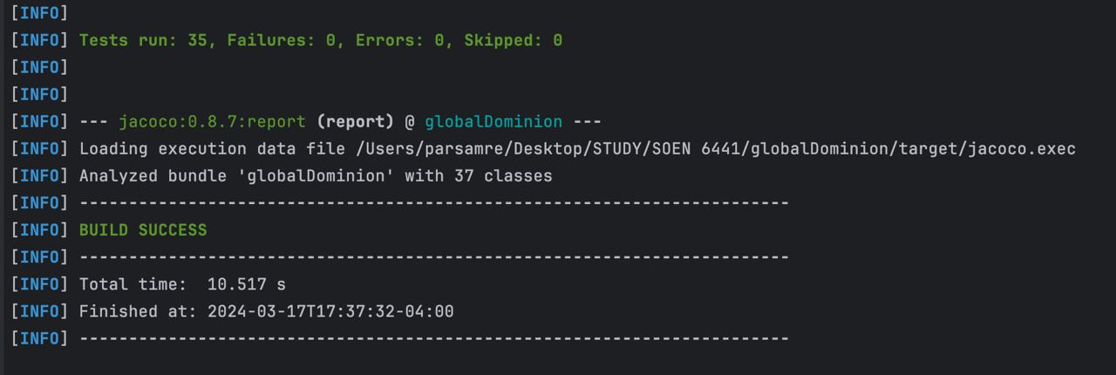

Slide 82
Git Hub Pictures

Slide 83
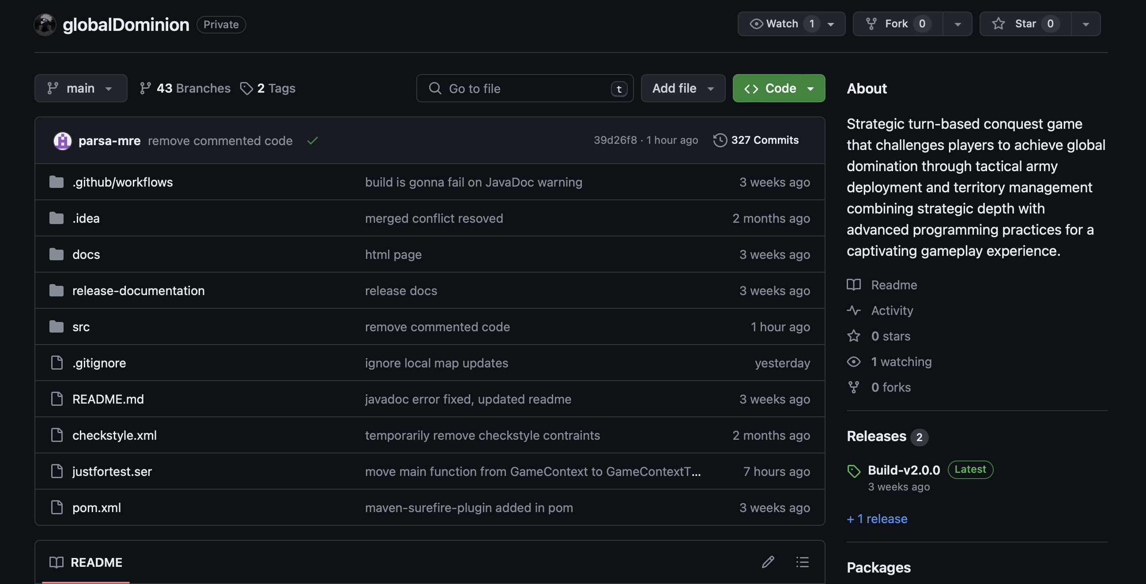

Slide 84
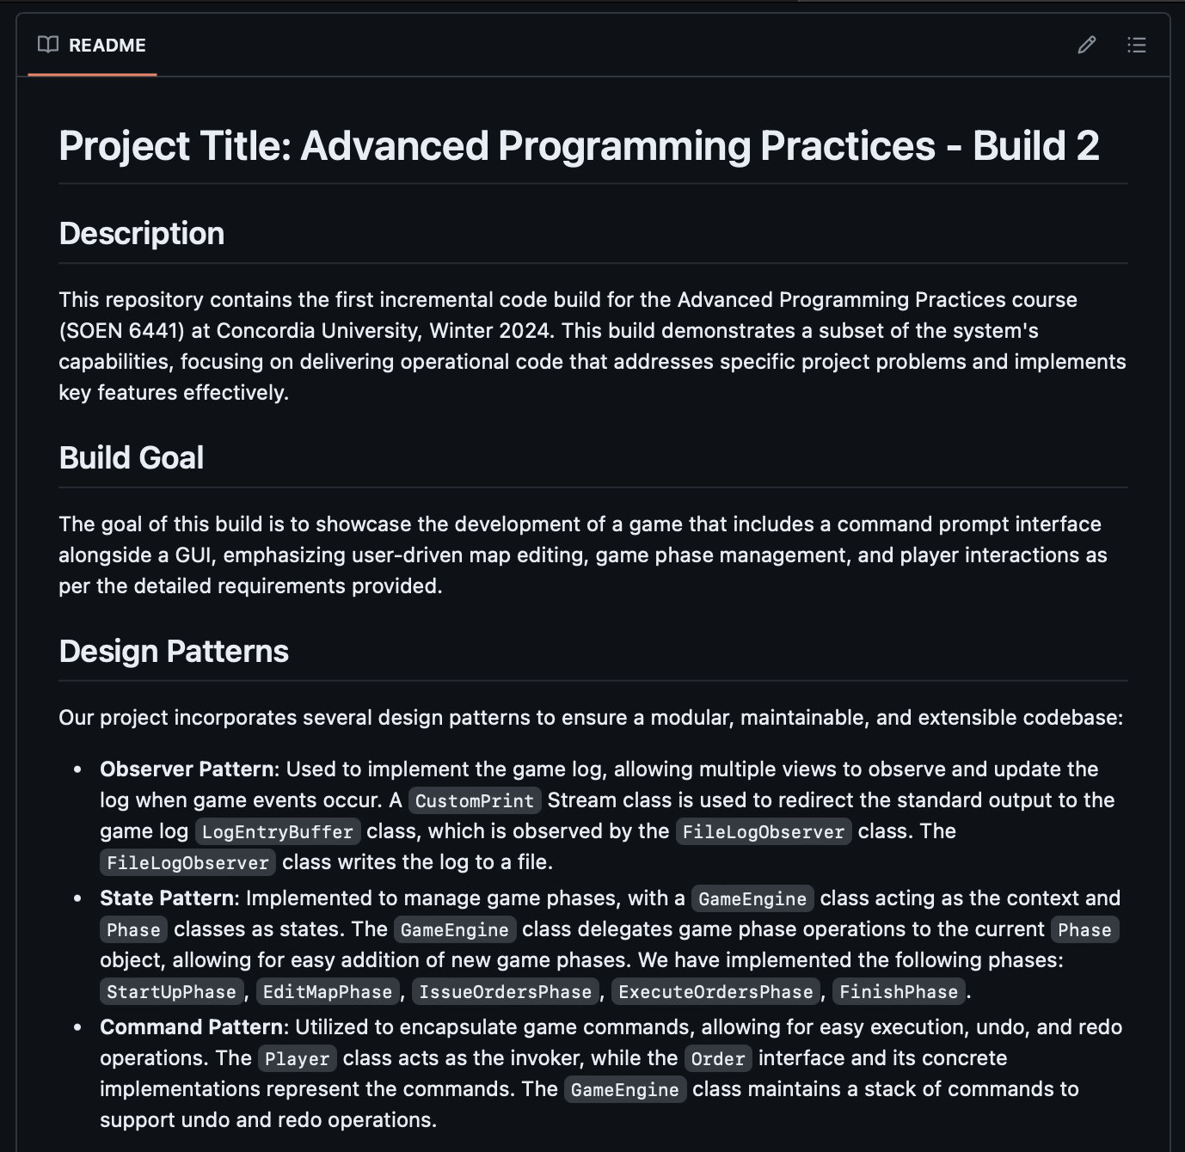

Slide 85
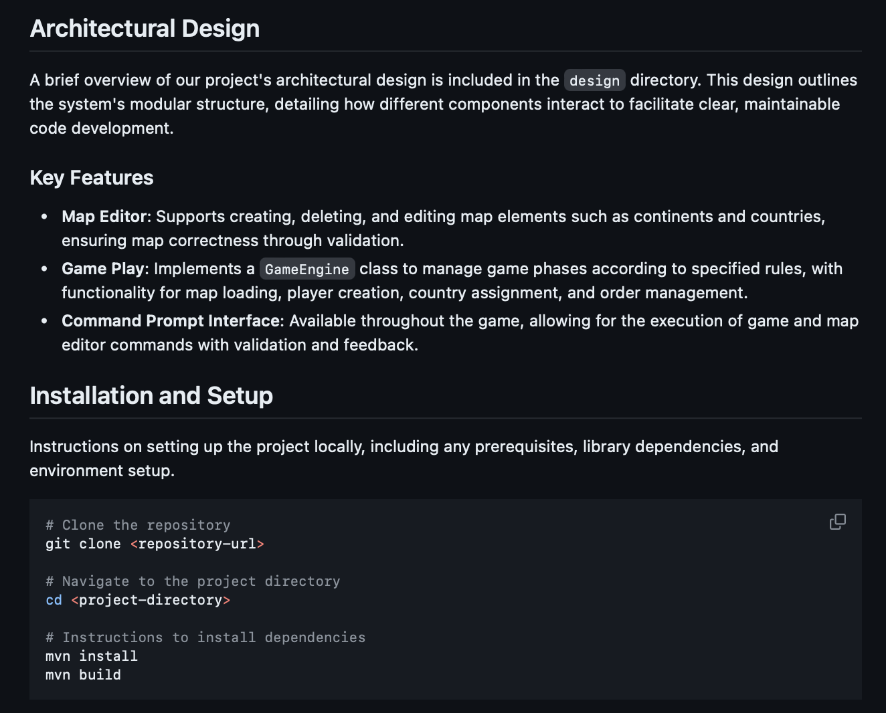

Slide 86
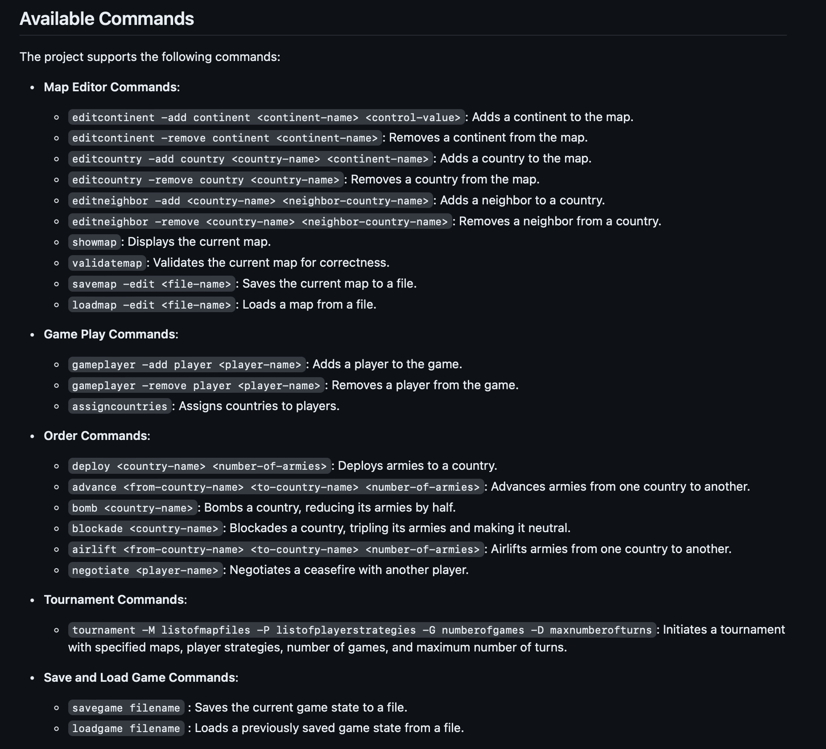

Slide 87
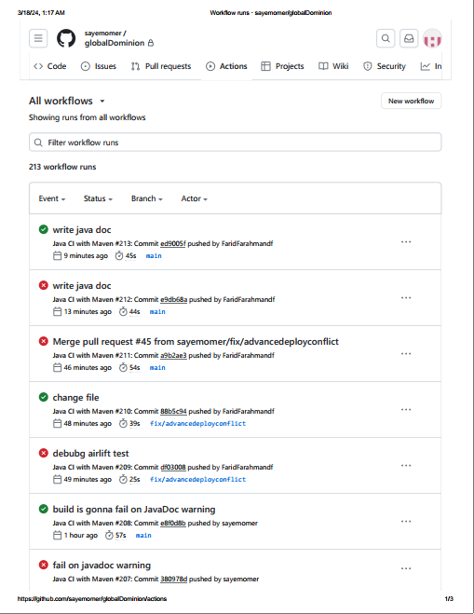
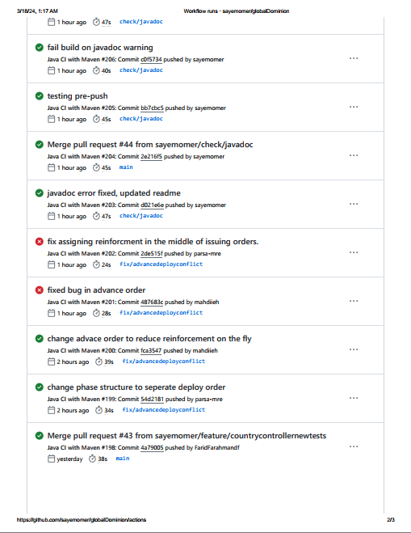

Slide 88
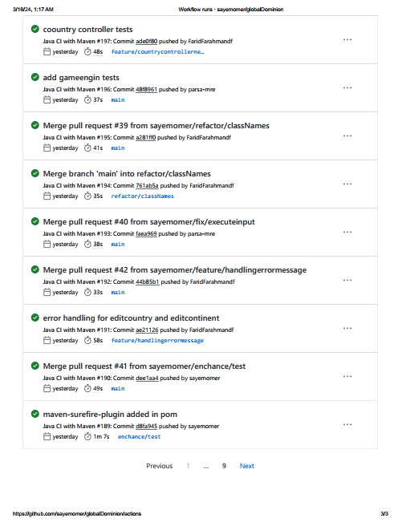

Slide 89


Slide 90
JavaDoc Pictures

Slide 91
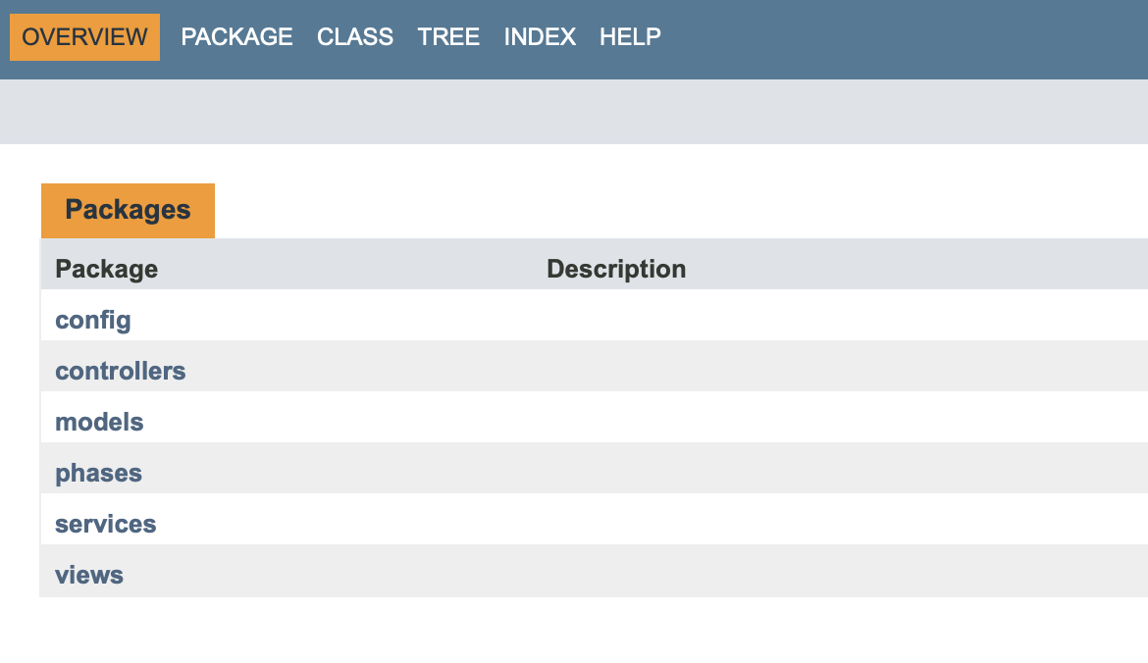

Slide 92
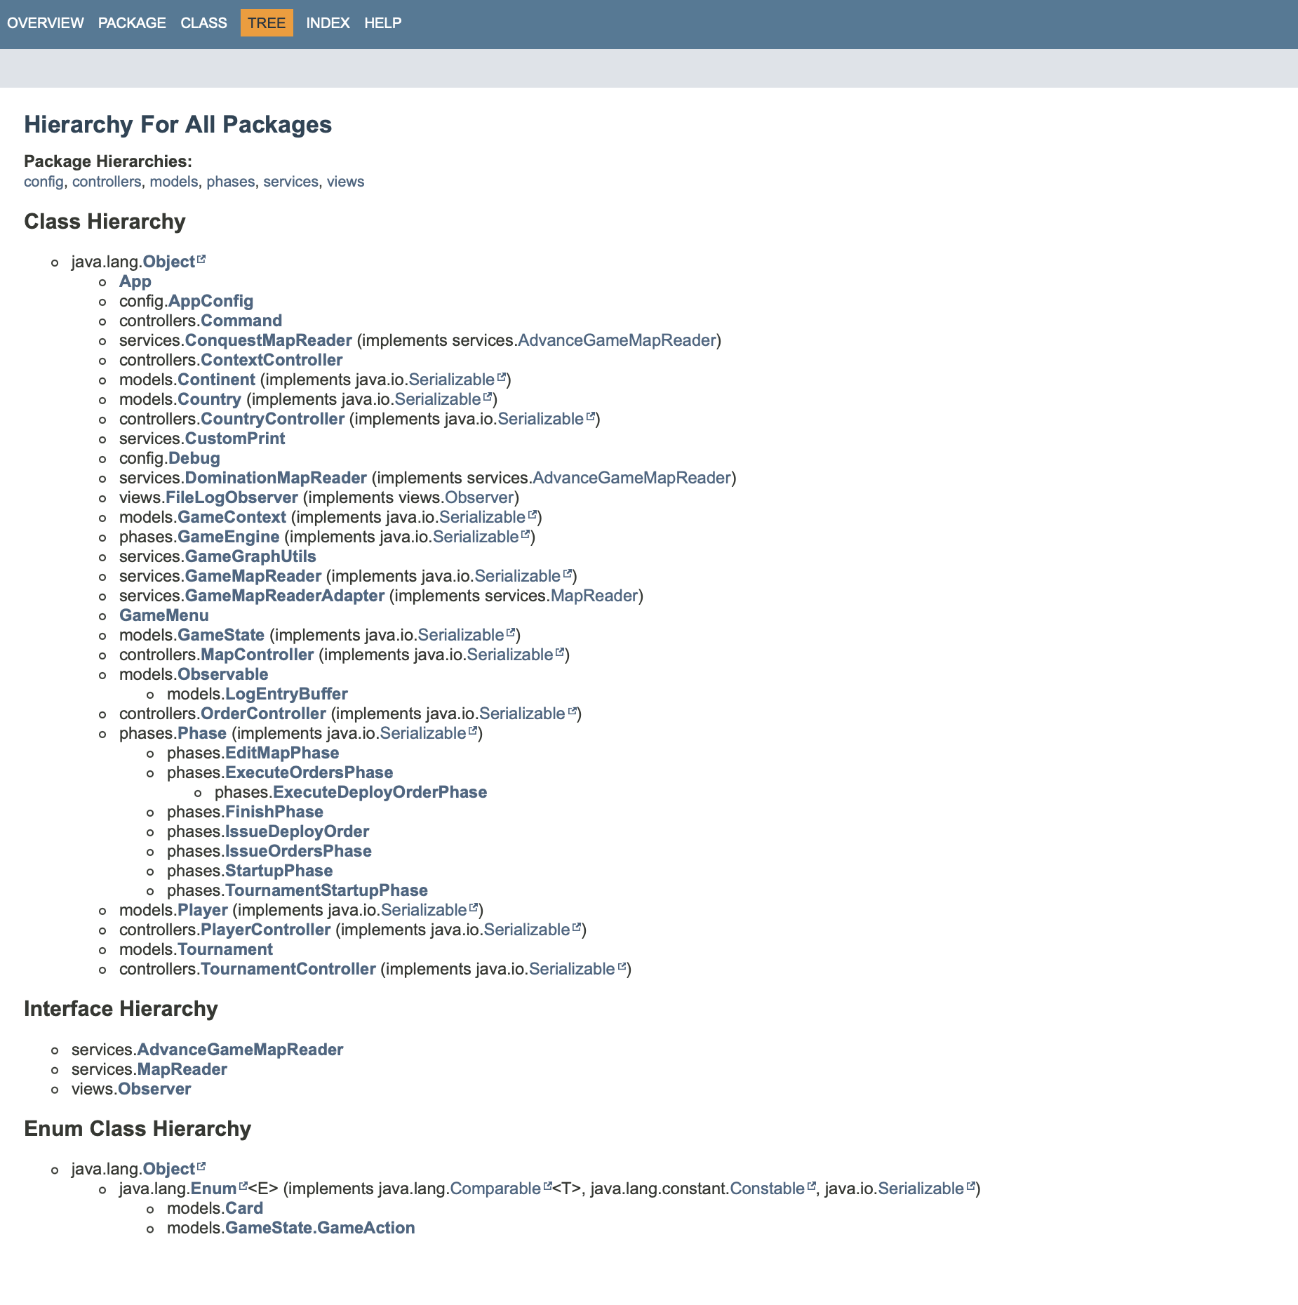

Slide 93
Thank you

